Slide 1

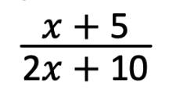
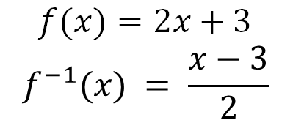
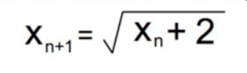
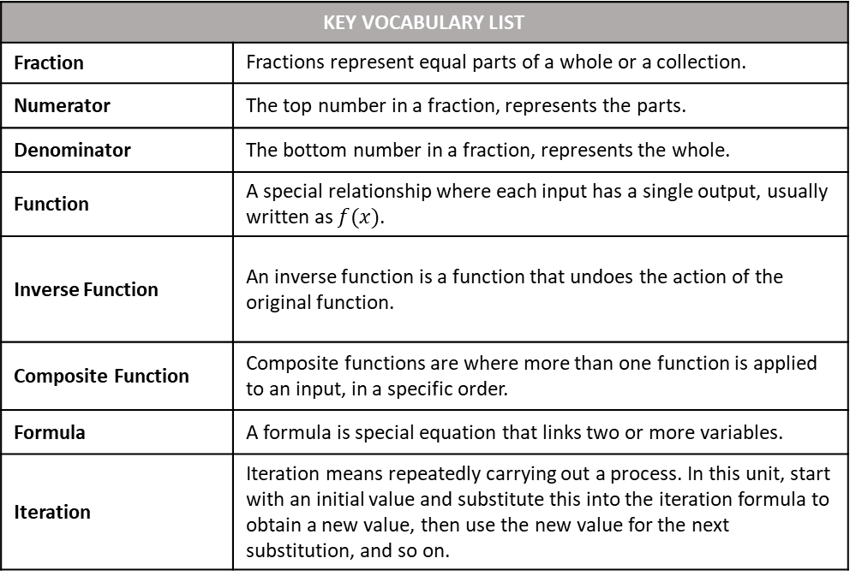
Name
Class
Tutor Group
YEAR 11 MATHEMATICS
Unit 1: Further Algebra PART 2 PART 2: Algebraic Fractions, Functions, Iteration, Proof
KEY VOCABULARY LIST
Fraction | Fractions represent equal parts of a whole or a collection.
Numerator | The top number in a fraction, represents the parts.
Denominator | The bottom number in a fraction, represents the whole.
Function | A special relationship where each input has a single output, usually written as $f(x)$.
Inverse Function | An inverse function is a function that undoes the action of the original function.
Composite Function | Composite functions are where more than one function is applied to an input, in a specific order.
Formula | A formula is special equation that links two or more variables.
Iteration | Iteration means repeatedly carrying out a process. In this unit, start with an initial value and substitute this into the iteration formula to obtain a new value, then use the new value for the next substitution, and so on.

Slide 2
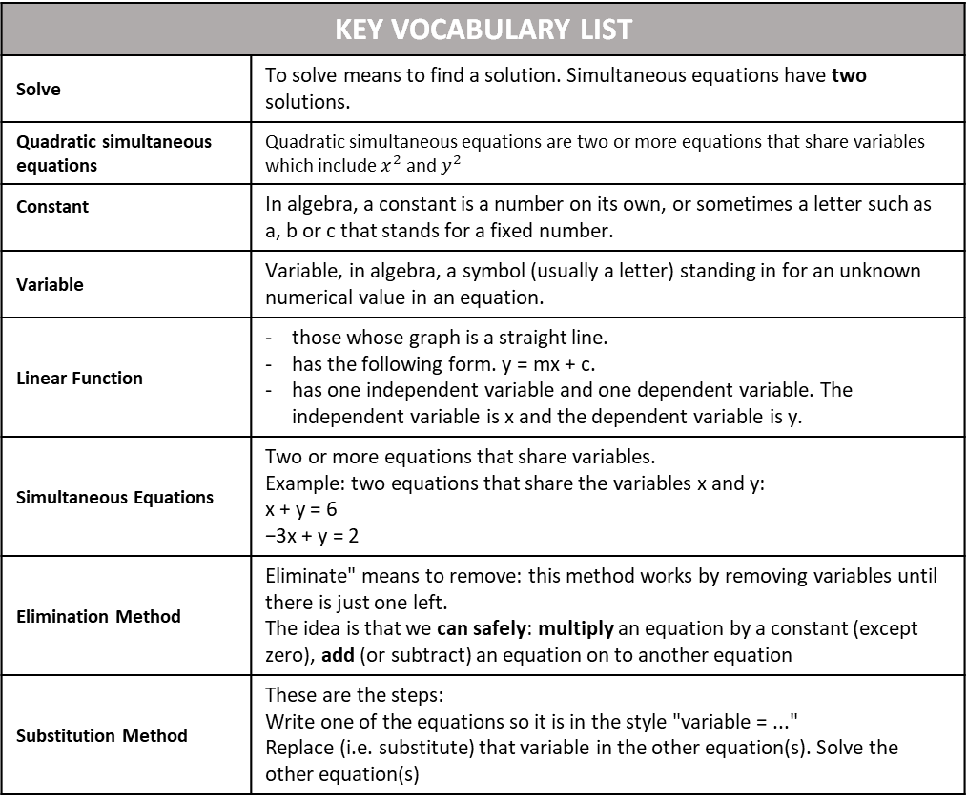
KEY VOCABULARY LIST
Solve | To solve means to find a solution. Simultaneous equations have two solutions.
Quadratic simultaneous equations | Quadratic simultaneous equations are two or more equations that share variables which include $x^{2}$ and $y^{2}$
Constant | In algebra, a constant is a number on its own, or sometimes a letter such as a, b or c that stands for a fixed number.
Variable | Variable, in algebra, a symbol (usually a letter) standing in for an unknown numerical value in an equation.
Linear Function | those whose graph is a straight line. has the following form. y = mx + c. has one independent variable and one dependent variable. The independent variable is x and the dependent variable is y.
Simultaneous Equations | Two or more equations that share variables. Example: two equations that share the variables x and y: x + y = 6 −3x + y = 2
Elimination Method | Eliminate" means to remove: this method works by removing variables until there is just one left. The idea is that we can safely: multiply an equation by a constant (except zero), add (or subtract) an equation on to another equation
Substitution Method | These are the steps: Write one of the equations so it is in the style "variable = ..." Replace (i.e. substitute) that variable in the other equation(s). Solve the other equation(s)

Slide 3
CONTENTS |  | PAGE
SUBTOPIC 1 | Rearranging Formulae/ Changing the Subject
 | GCSE QUESTIONS
SUBTOPIC 2 | Recap/ Prior Knowledge Quiz: Solving Quadratic Equations
SUBTOPIC 3a | Simultaneous Equations – elimination and graphical solving
SUBTOPIC 3b | Recap: Solving Simultaneous Equations by Elimination
SUBTOPIC 3c | Worded Simultaneous Equations
 | GCSE QUESTIONS
SUBTOPIC 3d | Solving Simultaneous Equations using Substitution
SUBTOPIC 3e | Quadratic Simultaneous Equations
 | GCSE QUESTIONS
SUBTOPIC 4a | Algebraic Fractions – Manipulation and Simplifying | 4
 | GCSE QUESTIONS | 24
SUBTOPIC 4b | Algebraic Fractions – Solving (including Quadratics) | 28
 | GCSE QUESTIONS | 36
SUBTOPIC 5 | Functions | 38
 | GCSE QUESTIONS | 50
SUBTOPIC 6a | Iteration 1: Recurrence Relationships | 55
 | GCSE QUESTIONS | 59
SUBTOPIC 6b | Iteration 2: Estimating Solutions | 61
 | GCSE QUESTIONS | 71
SUBTOPIC 7 | Algebraic Proof | 75
 | GCSE QUESTIONS | 85
BOOKLET STRUCTURE
Start of subtopic:
Read and annotate the information in the Frayer model or introduction text
I do (teacher led example).
We do (teacher and scholar led example).
You do (independent scholar example).
Whiteboard check.
Independent practice and mixed practice.
End of subtopic:
GCSE questions – to ensure you are confident with the style you will encounter in your exams

Slide 4
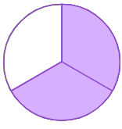
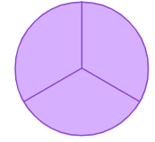

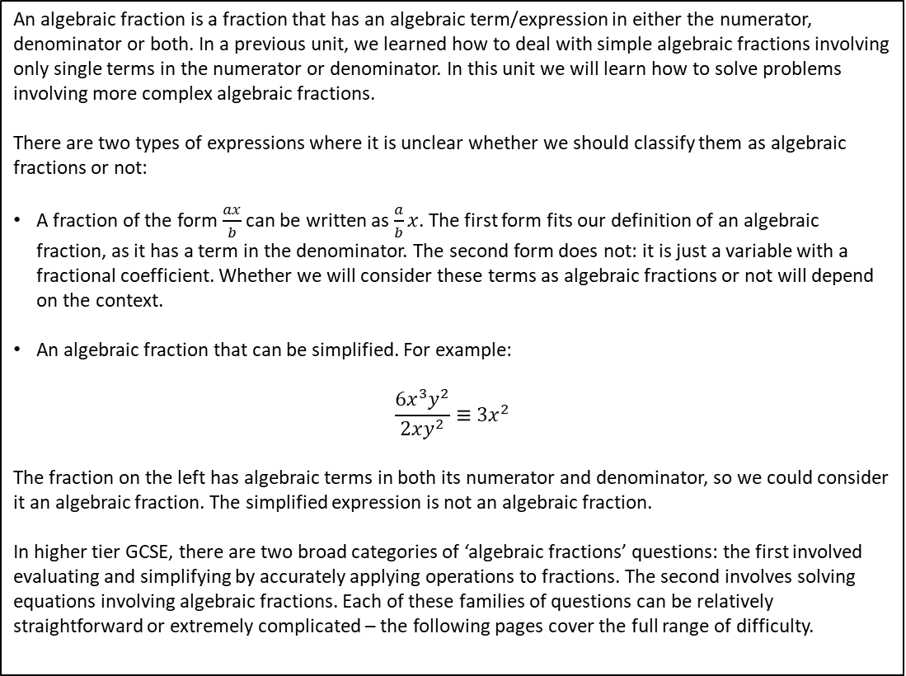
Subtopic 4a – Algebraic Fractions: Manipulation and Simplifying
LEARNING OUTCOME: To simplify and solve algebraic fractions.
Objectives:
Keywords:
Fraction
Solve
Factorise
Denominator
To be able to simplify basic algebraic fractions.
To be able to simplify algebraic fractions by factorising.
To multiply and divide with algebraic fractions.
To solve equations involving algebraic fractions.
An algebraic fraction is a fraction that has an algebraic term/expression in either the numerator, denominator or both. In a previous unit, we learned how to deal with simple algebraic fractions involving only single terms in the numerator or denominator. In this unit we will learn how to solve problems involving more complex algebraic fractions.
There are two types of expressions where it is unclear whether we should classify them as algebraic fractions or not:
A fraction of the form $\frac{ax}{b}$ can be written as $\frac{a}{b}x$. The first form fits our definition of an algebraic fraction, as it has a term in the denominator. The second form does not: it is just a variable with a fractional coefficient. Whether we will consider these terms as algebraic fractions or not will depend on the context.
An algebraic fraction that can be simplified. For example:
$$\frac{6x^{3}y^{2}}{2xy^{2}}≡3x^{2}$$
The fraction on the left has algebraic terms in both its numerator and denominator, so we could consider it an algebraic fraction. The simplified expression is not an algebraic fraction.
In higher tier GCSE, there are two broad categories of ‘algebraic fractions’ questions: the first involved evaluating and simplifying by accurately applying operations to fractions. The second involves solving equations involving algebraic fractions. Each of these families of questions can be relatively straightforward or extremely complicated – the following pages cover the full range of difficulty.
Definition
Characteristics
The numerator (top number) represents number of parts.
The denominator (bottom number) represents how many parts in the whole.
Each part must be equal.
A fraction represents a proportion - the number of parts of a whole when the whole has been split into equal parts.
Examples
Fractions
Non - Examples
= ⅔
= 1
= ⅕
= 3
1 × 20 = 20 | so 1 and 20 are both factors of 20
2 × 10 = 20 | so 2 and 10 are both factors of 20
4 × 5 = 20 | so 4 and 5 are both factors of 20
4

Slide 5
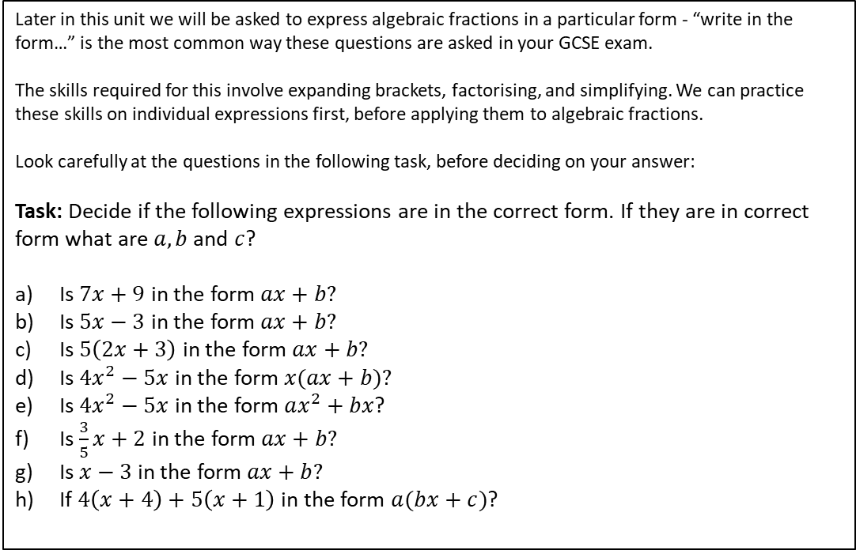
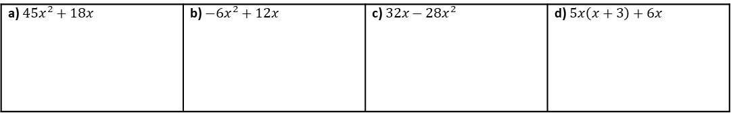
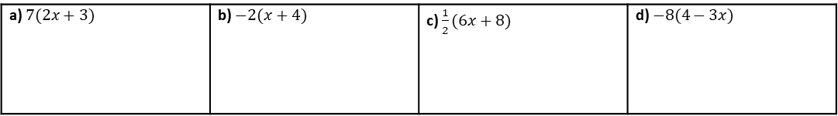
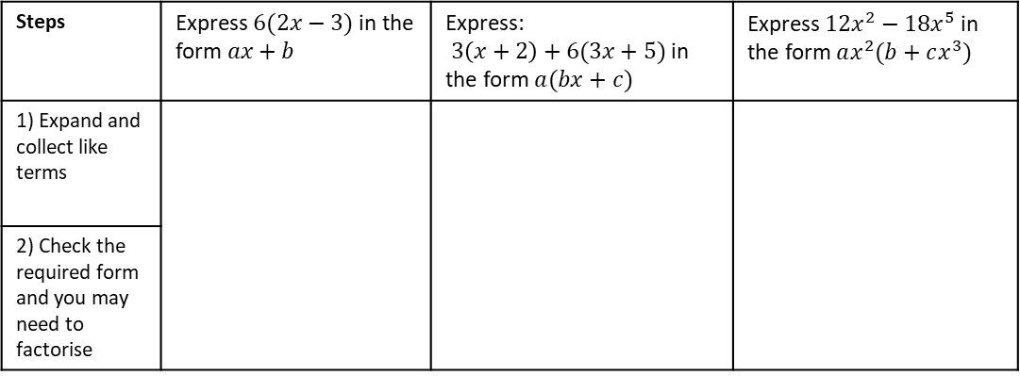
Writing in the correct form
Later in this unit we will be asked to express algebraic fractions in a particular form - “write in the form…” is the most common way these questions are asked in your GCSE exam.
The skills required for this involve expanding brackets, factorising, and simplifying. We can practice these skills on individual expressions first, before applying them to algebraic fractions.
Look carefully at the questions in the following task, before deciding on your answer:
Task: Decide if the following expressions are in the correct form. If they are in correct form what are $a, b$ and $c$?
Is $7x+9$ in the form $ax+b?$
Is $5x−3$ in the form $ax+b?$
Is $5\left(2x+3\right)$ in the form $ax+b?$
Is $4x^{2}−5x$ in the form $x(ax+b)?$
Is $4x^{2}−5x$ in the form $ax^{2}+bx$?
Is $\frac{3}{5}x+2$ in the form $ax+b?$
Is $x−3$ in the form $ax+b?$
If $4\left(x+4\right)+5\left(x+1\right)$ in the form $a(bx+c)$?
Example 1 - I do…
Example 2 - We do…
Example 3 - You do…
Steps | Express $6(2x−3)$ in the form $ax+b$ | Express: $3\left(x+2\right)+6(3x+5)$ in the form $a(bx+c)$ | Express $12x^{2}−18x^{5}$ in the form $ax^{2}(b+cx^{3})$
1) Expand and collect like terms
2) Check the required form and you may need to factorise
INDEPENDENT PRACTICE
Question 1: Express in the form $ax+b$
a) $7(2x+3)$ | b) $−2(x+4)$ | c) $\frac{1}{2}(6x+8)$ | d) $−8(4−3x)$
Question 2: Express in the form $ax(bx+c)$
a) $45x^{2}+18x$ | b) $−6x^{2}+12x$ | c) $32x−28x^{2}$ | d) $5x\left(x+3\right)+6x$

Slide 6
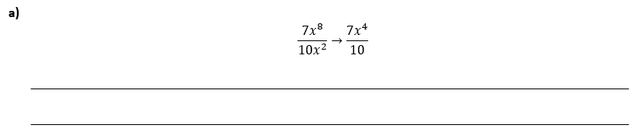


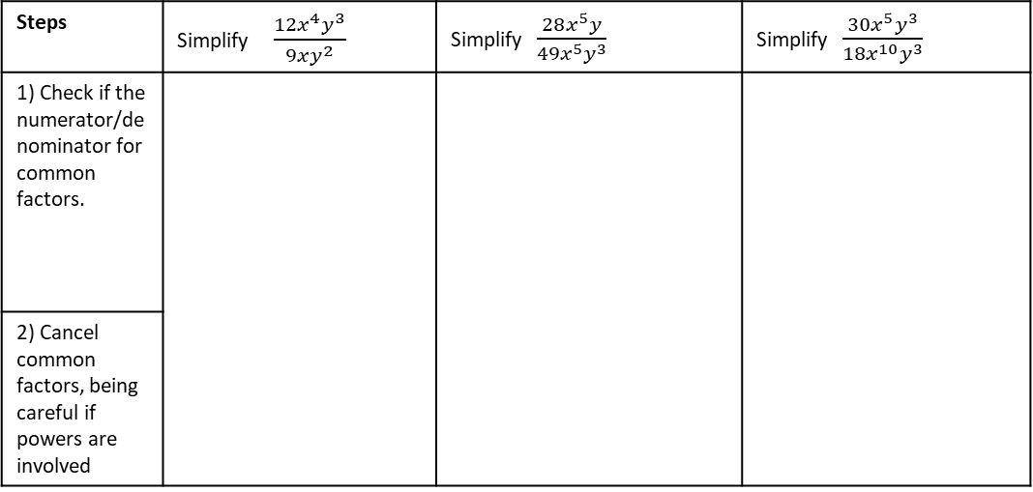








Simplifying basic algebraic fractions
The rules for simplifying algebraic fractions are like those for simplifying a normal fraction: divide (or occasionally multiply) the numerator and denominator by the same amount.
We begin below by simplifying fractions with only single terms in numerator and denominator:
Example 1 - I do…
Example 2 - We do…
Example 3 - You do…
Steps | Simplify $\frac{12x^{4}y^{3}}{9xy^{2}}$ | Simplify $\frac{28x^{5}y}{49x^{5}y^{3}}$ | Simplify $\frac{30x^{5}y^{3}}{18x^{10}y^{3}}$
1) Check if the numerator/denominator for common factors.
2) Cancel common factors, being careful if powers are involved
INDEPENDENT PRACTICE
1. Simplify these algebraic fractions:
a) $\frac{3}{12}$
b) $\frac{3x}{12}$
c) $\frac{3}{12x}$
d) $\frac{12x}{6}$
e) $\frac{12x}{6x}$
f) $\frac{12x^{2}}{3}$
g) $\frac{12x^{2}}{3x^{4}}$
h) $\frac{12a^{3}x^{2}}{3x^{2}}$
i) $\frac{12x}{3x^{2}}$
j) $\frac{10x^{7}y}{12x}$
2. Explain the mistake in the following simplification:

Slide 7
















Simplifying simple algebraic fractions using factorisation
Simplifying Algebraic Fractions will often use your knowledge of factorising – either into singe brackets or double brackets.
Knowledge Check
Factorise these expressions:
a) $4x+12$
b) $3x−9$
c) $6x−8$
d) $12x+30$
e) $x^{2}+4x+3$
f) $y^{2}+9y+8$
g) $n^{2}+6n+5$
h) $k^{2}+12k+35$
i) $x^{2}−4$
j) $y^{2}−16$
k) $x^{2}−49$
l) $x^{2}−121$
m) $2x^{2}−3x−9$
n) $3x^{2}+8x+4$
o) $4x^{2}−9x+2$
p) $3x^{2}+10x+7$

Slide 8




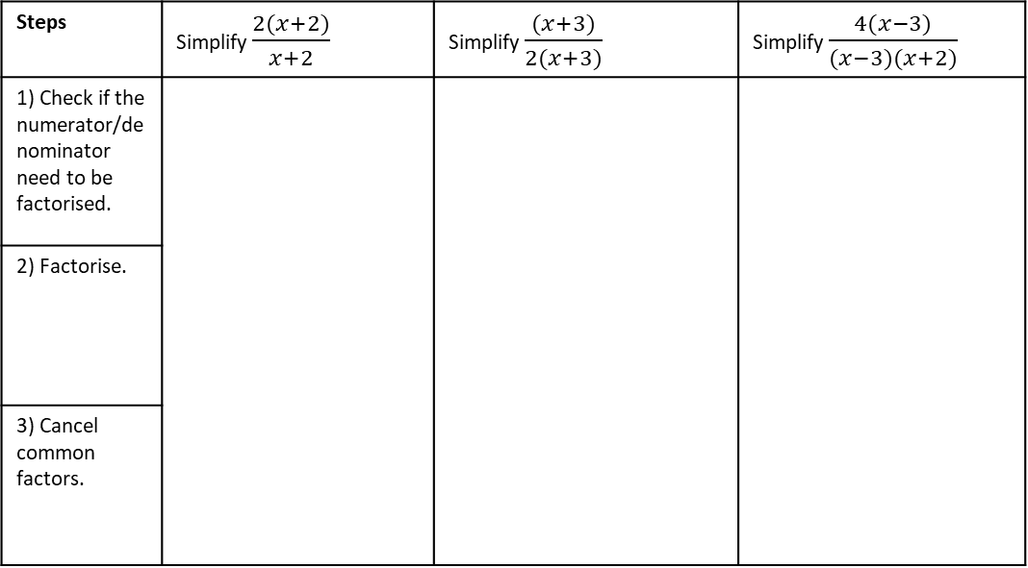






Example 1 - I do…
Example 2 - We do…
Example 3 - You do…
Steps | Simplify $\frac{2(x+2)}{x+2}$ | Simplify $\frac{(x+3)}{2(x+3)}$ | Simplify $\frac{4(x−3)}{(x−3)(x+2)}$
1) Check if the numerator/denominator need to be factorised.
2) Factorise.
3) Cancel common factors.
INDEPENDENT PRACTICE
1. Simplify the algebraic fractions.
a) $\frac{2(x+3)}{3(x+3)}$
b)$\frac{2(x+1)}{(x+3)}$
c)$\frac{\left(x+3\right)}{2(x−3)}$
d)$\frac{x+3}{2(x+3)}$
e) $\frac{\left(x+3\right)(x+6)}{(x+3)}$
f) $\frac{\left(x−1\right)(x+1)}{(x−1)}$
g) $\frac{\left(x−3\right)}{(x−4)(x−3)}$
h) $\frac{\left(x−3\right)(x+2)}{(x+2)(x+9)}$
i) $\frac{\left(x+3\right)(x+6)(x+2)}{(x+3)(x+2)(x−4)}$
j)$\frac{\left(x−3\right)(2x−1)(x+2)}{(x−3)(x+2)(2x−1)}$

Slide 9



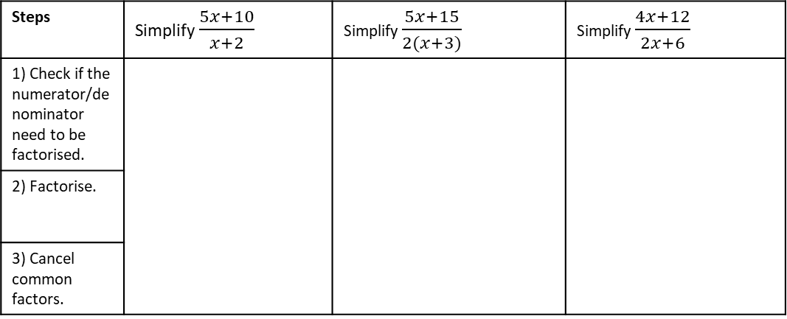

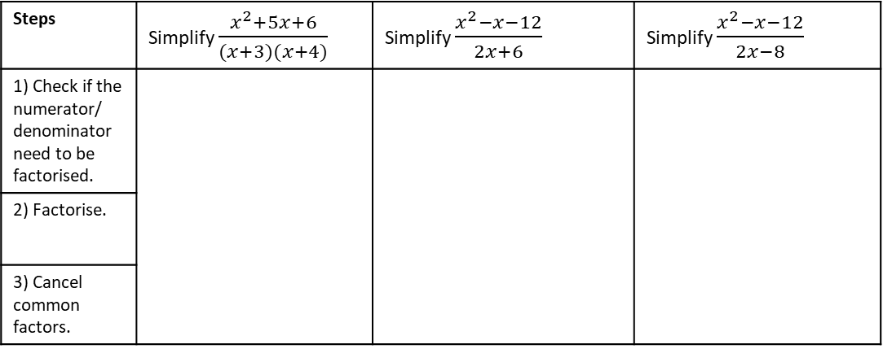




Example 4 - I do…
Example 5 - We do…
Example 6 - You do…
Steps | Simplify $\frac{5x+10}{x+2}$ | Simplify $\frac{5x+15}{2(x+3)}$ | Simplify $\frac{4x+12}{2x+6}$
1) Check if the numerator/denominator need to be factorised.
2) Factorise.
3) Cancel common factors.
INDEPENDENT PRACTICE
2. Simplify the algebraic fractions.
a) $\frac{2x+2}{3(x+1)}$
b)$\frac{2x+2}{3x+3}$
c)$\frac{3x+3}{2(x+1)}$
d)$\frac{x+3}{2(x+3)}$
e) $\frac{4x+12}{3(x+3)}$
f) $\frac{4x+12}{(x+1)(x+3)}$
g) $\frac{x+3}{4x+12}$
h) $\frac{5x+15}{x+3}$
Example 7 - I do…
Example 8 - We do…
Example 9 - You do…
Steps | Simplify $\frac{x^{2}+5x+6}{(x+3)(x+4)}$ | Simplify $\frac{x^{2}−x−12}{2x+6}$ | Simplify $\frac{x^{2}−x−12}{2x−8}$
1) Check if the numerator/ denominator need to be factorised.
2) Factorise.
3) Cancel common factors.

Slide 10










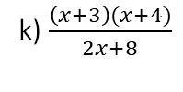

i) $\frac{\left(x+3\right)(x+6)}{2x+6}$
j) $\frac{\left(x+3\right)(x+4)}{2x+6}$
k) $\frac{\left(x+3\right)(x+4)}{2x+8}$
l)$\frac{x^{2}+7x+12}{2x+8}$
m) $\frac{x^{2}+7x+12}{(x+4)(x−9)}$
n) $\frac{x^{2}+7x+12}{x^{2}−5x−36}$
o) $\frac{2x^{2}+14x+24}{x^{2}−5x−36}$
p) $\frac{2x^{2}+14x+24}{3x^{2}−15x−108}$
q) $\frac{{2x}^{2}+14x+24}{3x^{2}+4x−15}$
r) $\frac{14x−24−2x^{2}}{{3x}^{2}+4x−15}$
s) $\frac{14x−24−2x^{2}}{3x^{2}−4x−15}$
t) $\frac{10x^{2}−23x+12}{4x^{2}+4x−15}$

Slide 11





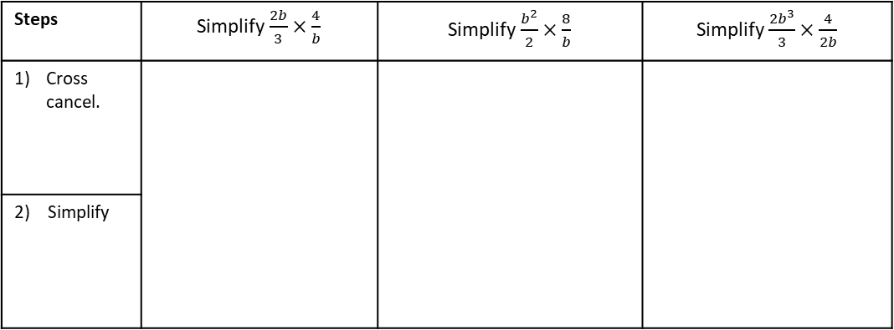



Multiplying and Dividing Algebraic Fractions
Multiplying and diving single term algebraic fractions works similarly to the numerical case:
For multiplication, the new numerator is the product of the numerators, the new denominator is the product of the denominators. Once the numerator and denominator are calculated, simplify if possible.
For division we need to rewrite the calculation so that we are multiplying by the reciprocal of the second fraction.
Knowledge Check: Cross Simplification
a) $\frac{3}{15}×\frac{5}{11}=$
b) $\frac{5}{14}×\frac{21}{15}=$
c) $\frac{13}{80}×\frac{20}{39}=$
Example 13 - I do…
Example 14 - We do…
Example 15 - You do…
Steps | Simplify$\frac{2b}{3}×\frac{4}{b}$ | Simplify$\frac{b^{2}}{2}×\frac{8}{b}$ | Simplify$\frac{2b^{3}}{3}×\frac{4}{2b}$
Cross cancel.
2) Simplify
INDEPENDENT PRACTICE
3. Simplify the algebraic fractions.
a) $\frac{b}{4}×\frac{4}{b}$
b) $\frac{b^{2}}{4}×\frac{4}{b}$
c) $\frac{b^{3}}{4}×\frac{4}{2b^{2}}$
d) $\frac{b^{3}}{4}×\frac{8}{2b^{2}}$
e) $\frac{8}{b^{3}}×\frac{2b^{2}}{4}$

Slide 12

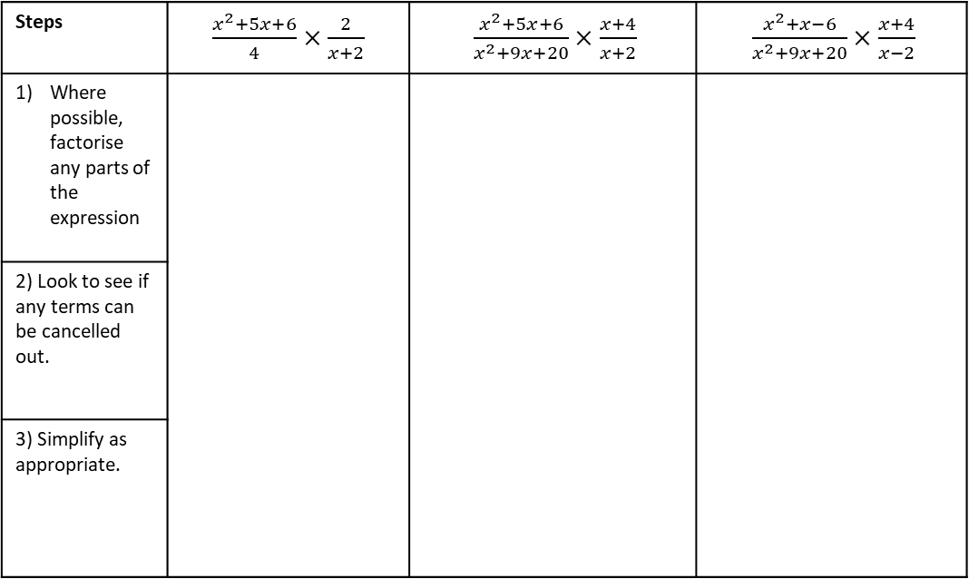
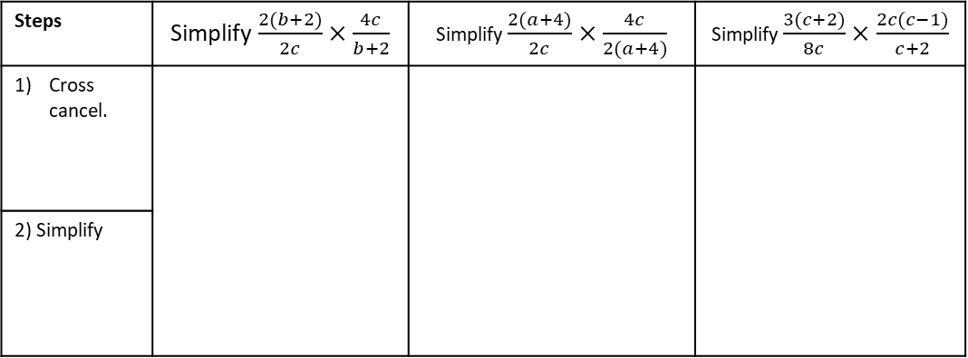



Example 16 - I do…
Example 17 - We do…
Example 18 - You do…
Steps | Simplify$\frac{2(b+2)}{2c}×\frac{4c}{b+2}$ | Simplify $\frac{2(a+4)}{2c}×\frac{4c}{2(a+4)}$ | Simplify $\frac{3(c+2)}{8c}×\frac{2c(c−1)}{c+2}$
Cross cancel.
2) Simplify
INDEPENDENT PRACTICE
4. Simplify the algebraic fractions.
a) $\frac{2(x+2)}{2c}×\frac{4c}{x+2}$
b) $\frac{2(x−2)}{2c}×\frac{4c}{x−2}$
c) $\frac{2(x+2)}{2c^{3}}×\frac{4c^{2}}{x+2}$
d) $\frac{2x+4}{2c}×\frac{4c^{3}}{x+2}$
Example 16 - I do…
Example 17 - We do…
Example 18 - You do…
Steps | $\frac{x^{2}+5x+6}{4}×\frac{2}{x+2}$ | $\frac{x^{2}+5x+6}{x^{2}+9x+20}×\frac{x+4}{x+2}$ | $\frac{x^{2}+x−6}{x^{2}+9x+20}×\frac{x+4}{x−2}$
Where possible, factorise any parts of the expression
2) Look to see if any terms can be cancelled out.
3) Simplify as appropriate.

Slide 13

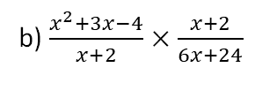
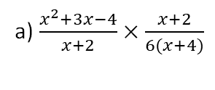
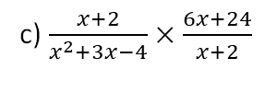
INDEPENDENT PRACTICE
5. Simplify the algebraic fractions.
a) $\frac{x^{2}+3x−4}{x+2}×\frac{x+2}{6(x+4)}$
b) $\frac{x^{2}+3x−4}{x+2}×\frac{x+2}{6x+24}$
c) $\frac{x+2}{x^{2}+3x−4}×\frac{6x+24}{x+2}$
d) $\frac{{\left(x+1\right)}^{2}}{x^{2}+3x−4}×\frac{x−1}{x+1}$

Slide 14

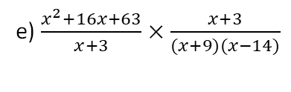
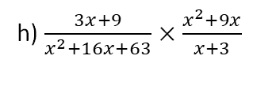

e) $\frac{x^{2}+16x+63}{x+3}×\frac{x+3}{(x+9)(x−14)}$
f) $\frac{x^{2}+16x+63}{x+3}×\frac{x+3}{x^{2}+9x}$
g)$\frac{x^{2}+16x+63}{3x+9}×\frac{x+3}{x^{2}+9x}$
h) $\frac{3x+9}{x^{2}+16x+63}×\frac{x^{2}+9x}{x+3}$

Slide 15
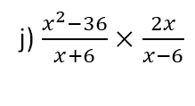
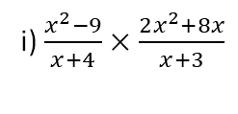
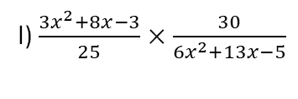
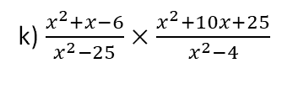
i) $\frac{x^{2}−9}{x+4}×\frac{2x^{2}+8x}{x+3}$
j) $\frac{x^{2}−36}{x+6}×\frac{2x}{x−6}$
k) $\frac{x^{2}+x−6}{x^{2}−25}×\frac{x^{2}+10x+25}{x^{2}−4}$
l) $\frac{3x^{2}+8x−3}{25}×\frac{30}{6x^{2}+13x−5}$

Slide 16
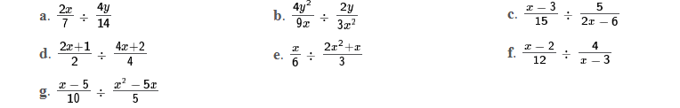
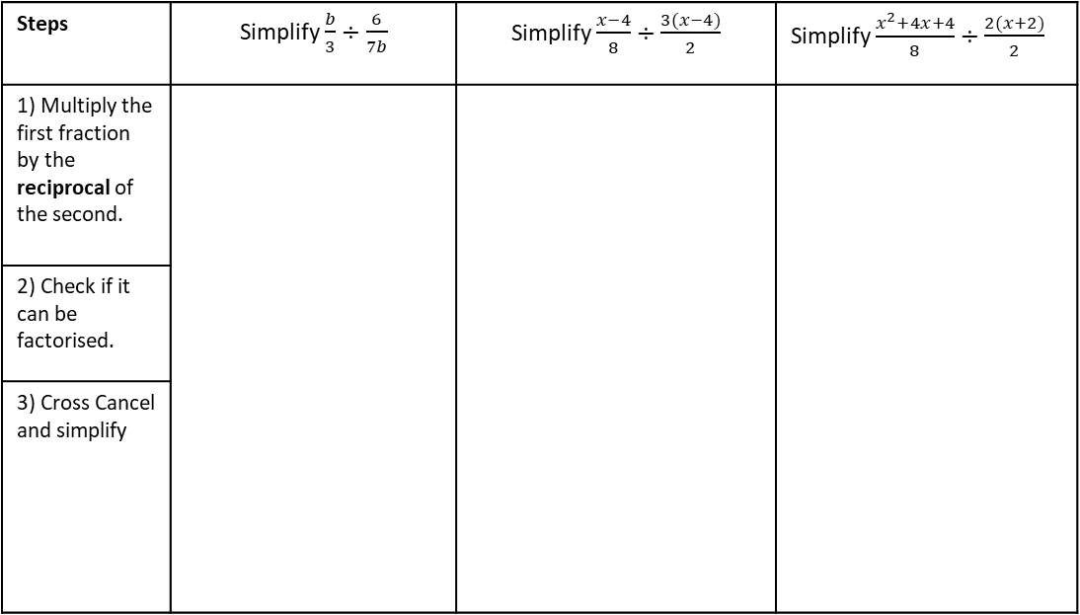

Example 19 - I do…
Example 20 - We do…
Example 21 - You do…
Steps | Simplify $\frac{b}{3}÷\frac{6}{7b}$ | Simplify $\frac{x−4}{8}÷\frac{3(x−4)}{2}$ | Simplify $\frac{x^{2}+4x+4}{8}÷\frac{2(x+2)}{2}$
1) Multiply the first fraction by the reciprocal of the second.
2) Check if it can be factorised.
3) Cross Cancel and simplify
INDEPENDENT PRACTICE
6. Simplify the algebraic fractions.
h. $\frac{3x+9}{2}÷\frac{x+3}{4}$

Slide 17
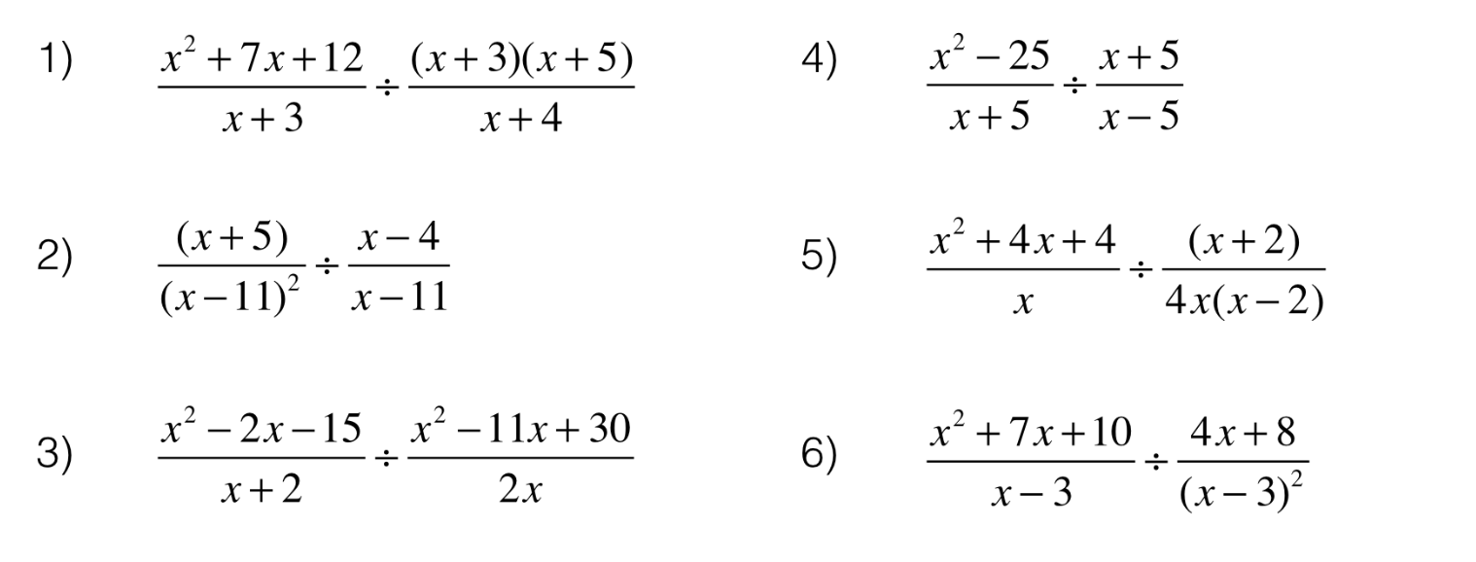







INDEPENDENT PRACTICE
i. $\frac{4}{x−2}÷\frac{3}{x^{2}−2x}$
j. $\frac{11}{4x^{2}+2x}÷\frac{3}{2x+1}$
k. $\frac{x+3}{x+1}÷\frac{x}{{\left(x+1\right)}^{2}}$
l. $\frac{x^{2}}{7}÷\frac{6x^{3}+8x^{2}}{x^{2}−7x}$
m. $\frac{x^{2}+7x+10}{2}÷\frac{x^{2}+4x−5}{4}$
n. $\frac{14}{x^{2}−5x+6}÷\frac{7}{x^{2}+3x−10}$
o. $\frac{x+4}{x+5}÷\frac{3x+12}{x^{2}−25}$
p.
q.

Slide 18
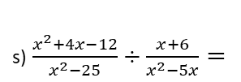
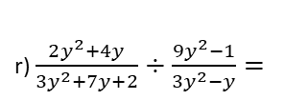



r) $\frac{2y^{2}+4y}{3y^{2}+7y+2}÷\frac{9y^{2}−1}{3y^{2}−y}=$
s)$\frac{x^{2}+4x−12}{x^{2}−25}÷\frac{x+6}{x^{2}−5x}=$
t) $\frac{3x^{2}−5x−2}{x^{2}−4x}÷\frac{3x+1}{x^{2}−8x+16}$
u) $\frac{3x^{2}+8x−3}{25}÷\frac{6x^{2}+13x−5}{30}$
v) $\frac{x^{3}−x}{x^{4}−1}÷\frac{x+1}{x^{3}+x}$

Slide 19
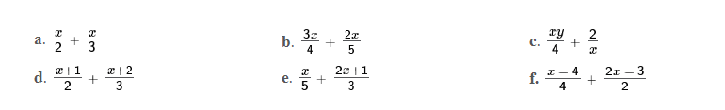













Adding and Subtracting Algebraic Fractions
When the algebraic fractions we want to add or subtract have different denominators, it is necessary to find a common denominator. As with numerical fractions we do this by finding the lowest common multiple of the denominators.
Knowledge Check
Evaluate and simplify the following:
a) $\frac{1}{4}+\frac{1}{3}$
b) $\frac{1}{6}+\frac{2}{5}$
c) $\frac{3}{10}−\frac{1}{5}$
d) $\frac{3}{7}+\frac{2}{5}$
e) $\frac{5}{6}−\frac{5}{7}$
Example 22 - I do…
Example 23 - We do…
Example 24 - You do…
Simplify $\frac{x}{7}+\frac{3x}{8}$
Steps
1) Find the Lowest common denominator
2) Multiply the numerators.
3) Write in simplest form.
Simplify $\frac{x}{5}+\frac{3x}{8}$
Simplify $\frac{2x}{5}+\frac{3x}{7}$
INDEPENDENT PRACTICE
a) $\frac{3x}{2}+\frac{4x}{5}$
b) $\frac{x}{2}+\frac{4x}{5}$
c) $\frac{x}{2}+\frac{x}{5}$
d) $\frac{x}{2}−\frac{x}{5}$
e) $\frac{5x}{5}−\frac{x}{2}$

Slide 20








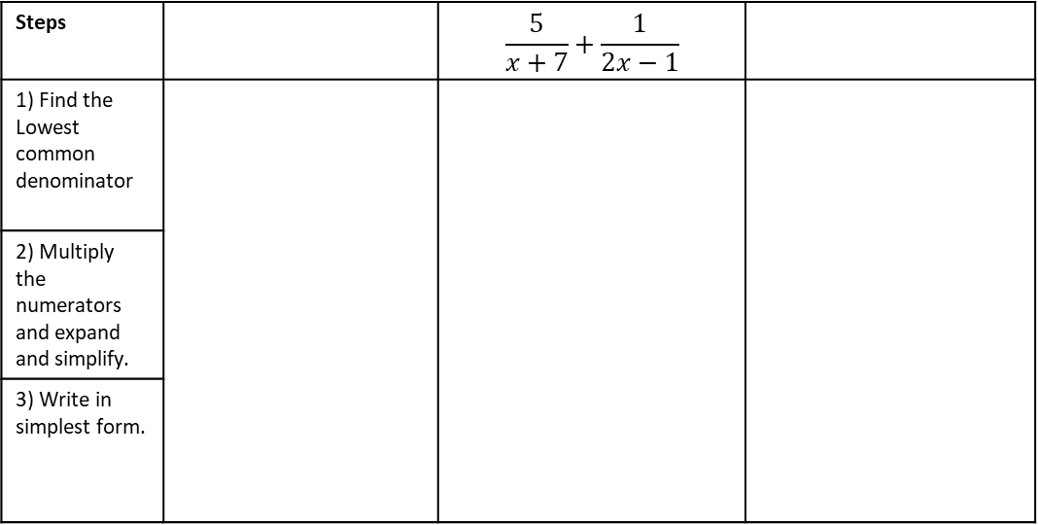


Example 25 - I do…
Example 26 - We do…
Example 27 - You do…
Simplify $\frac{x+1}{2}+\frac{x+3}{3}$
Simplify $\frac{x+5}{3}+\frac{x−2}{4}$
Steps |  | $$\frac{5}{x+7}+\frac{1}{2x−1}$$
1) Find the Lowest common denominator
2) Multiply the numerators and expand and simplify.
3) Write in simplest form.
INDEPENDENT PRACTICE
7. Simplify the algebraic fractions.
a) $\frac{x+2}{4}+\frac{x+2}{5}$
c) $\frac{x−3}{4}+\frac{x+2}{3}$
d) $\frac{3}{x−1}+\frac{4}{3x+2}$
e) $\frac{x−1}{5}+\frac{x+2}{3}$
f) $\frac{x−4}{4}+\frac{2x−3}{2}$
g) $\frac{3x+2}{4}−\frac{x−2}{5}$
h) $\frac{4x+2}{2}−\frac{x+3}{3}$
i) $\frac{2x+1}{4}−\frac{2x−1}{3}$

Slide 21











j) $\frac{2x+1}{2}−\frac{2x+1}{4}$
k) $\frac{3x−2}{2}−\frac{4x−3}{4}$
l) $\frac{5x−4}{4}−\frac{2x−3}{2}$
m) $\frac{7x+5}{5}−\frac{2x+1}{3}$
Example 28 - I do…
Example 29 - We do…
Example 30 - You do…
Simplify $\frac{7}{3x}+\frac{5}{x^{2}}$
Steps
1) Find the Lowest common denominator
2) Multiply the numerators and expand and simplify.
3) Write in simplest form.
Simplify $\frac{5}{x}+\frac{8}{3x}$
Simplify $\frac{7}{2x}+\frac{2}{x^{2}}$
INDEPENDENT PRACTICE
8. Simplify the algebraic fractions.
a) $\frac{5}{x}+\frac{2}{x}$
b) $\frac{5}{x^{2}}+\frac{2}{x}$
c) $\frac{5}{2x^{2}}−\frac{2}{x}$
d) $\frac{6}{2x^{2}}−\frac{2}{x}$

Slide 22




DEPTH: ADDING AND SUBTRACTING INVOLVING QUADRATICS/DOUBLE BRACKETS
When we are adding and subtracting algebraic fractions, it is sometimes necessary to either expand double brackets or factorise quadratics.
Steps
1) Find the Lowest common denominator
2) Multiply the numerators and expand and collect terms..
3) Check if any final simplification is possible .
Example 31 - I do…
Example 32 - You do…
Express the following as a single simplified fraction.
$$\frac{x−3}{x+2}+\frac{x+5}{x−2}$$
Express the following as a single simplified fraction.
$$\frac{x+7}{x−3}+\frac{x−2}{x+4}$$
Steps
1) Find the Lowest common denominator
2) Multiply the numerators and expand and collect terms..
3) Check if any final simplification is possible .
Example 33 - I do…
Example 34 - You do…
Express the following a single simplified fraction.
$$\frac{10x+9}{x^{2}+6x+5}−\frac{3}{x+5}$$
Express the following a single simplified fraction.
$$\frac{4x+1}{x^{2}−2x−15}−\frac{3}{x+3}$$

Slide 23
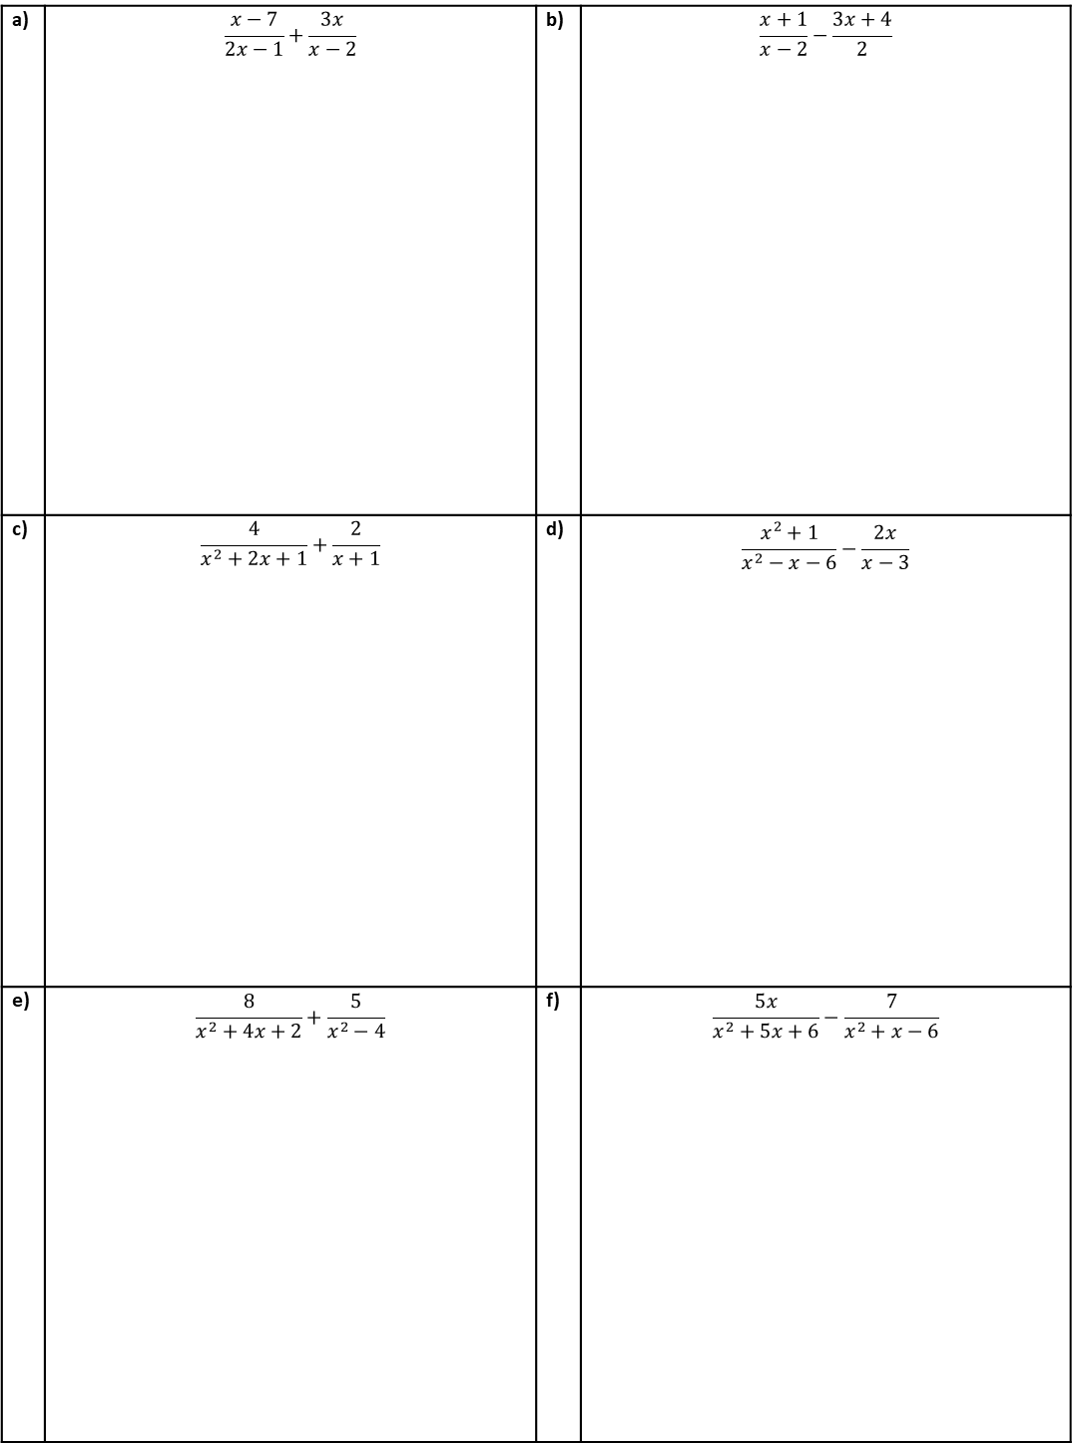
INDEPENDENT PRACTICE
Question 9. Write as a single fraction, simplify where possible.
a) | $$\frac{x−7}{2x−1}+\frac{3x}{x−2}$$ | b) | $$\frac{x+1}{x−2}−\frac{3x+4}{2}$$
c) | $$\frac{4}{x^{2}+2x+1}+\frac{2}{x+1}$$ | d) | $$\frac{x^{2}+1}{x^{2}−x−6}−\frac{2x}{x−3}$$
e) | $$\frac{8}{x^{2}+4x+2}+\frac{5}{x^{2}−4}$$ | f) | $$\frac{5x}{x^{2}+5x+6}−\frac{7}{x^{2}+x−6}$$

Slide 24
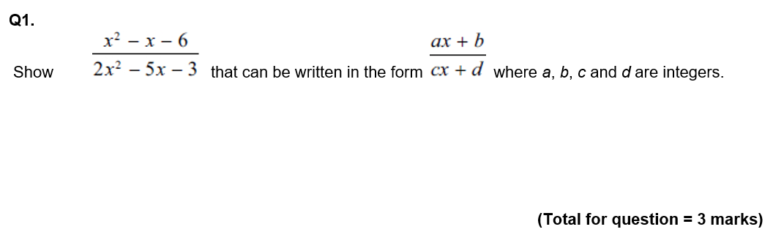
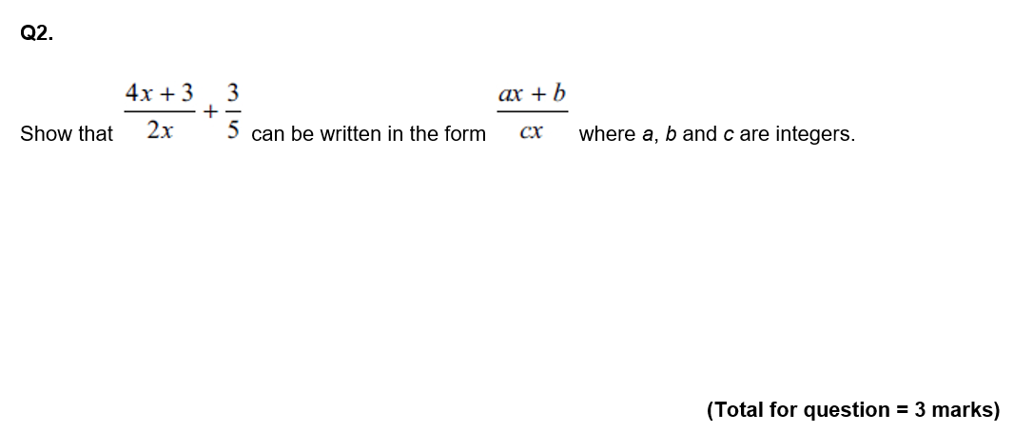
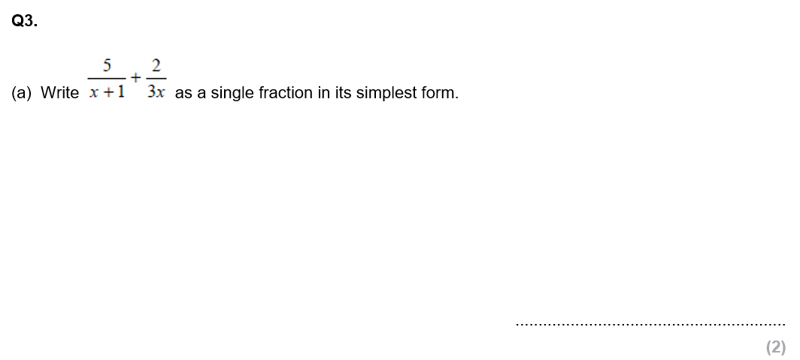
GCSE QUESTIONS

Slide 25
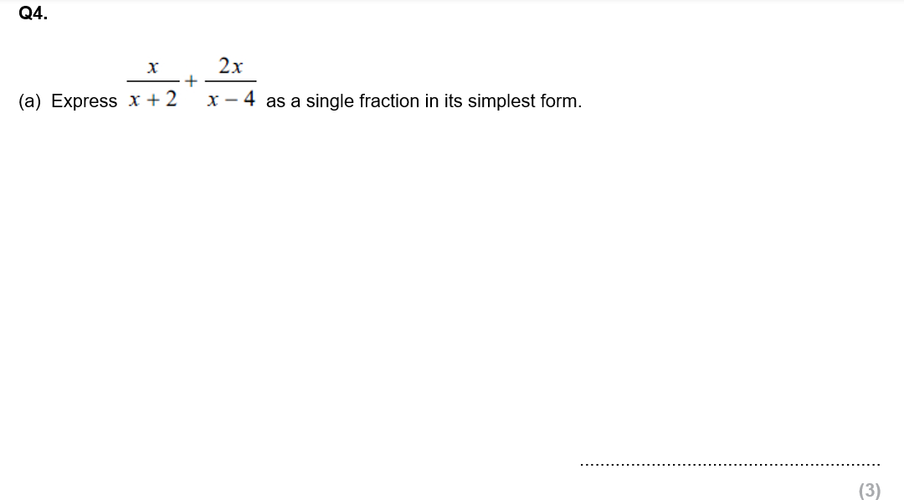
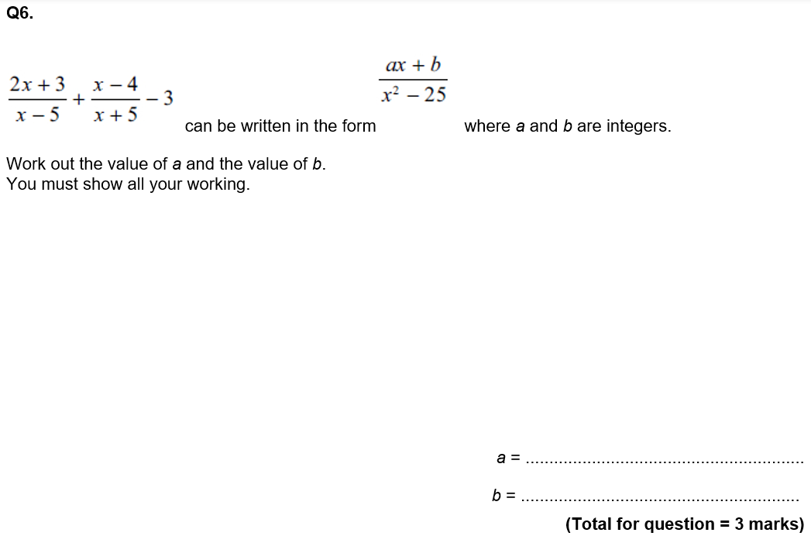

Slide 26
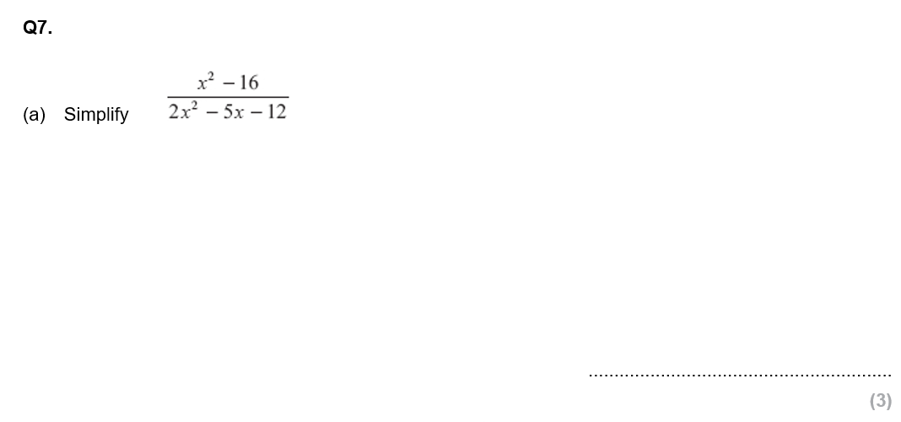
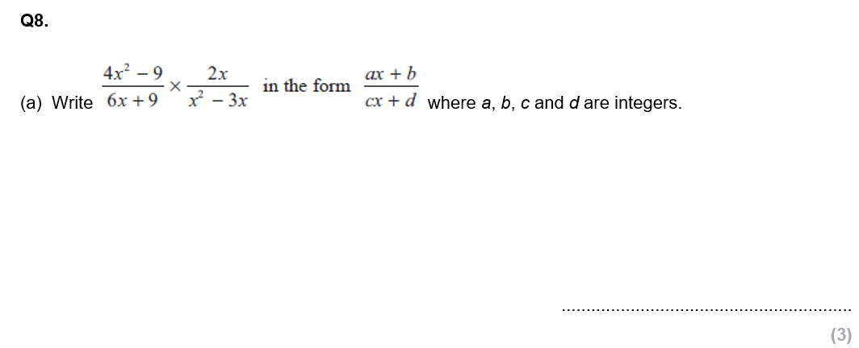


Slide 27



Slide 28








Subtopic 4b – Algebraic Fractions: Solving
We can solve equations involving algebraic fractions in one of two ways:
Simplify the equation so that each side is either a single algebraic fraction or an expression. Multiply through by the denominators of any algebraic fractions – leaving an equation with no algebraic fractions to be solved.
Calculate the lowest common multiple of the denominators of the algebraic fractions. Multiply through by this expression to again reach an equation free of algebraic fractions.
Before we do this, we need to recap the solving of equations involving fractions that you have seen before. Attempt the questions below independently, showing clearly what you do for the steps at each stage.
Knowledge Check
a) $\frac{x+5}{7}=5$
b)$\frac{3x−2}{5}=4$
c) $\frac{x−4}{7}=3$
d) $3=\frac{2y+1}{5}$
e) $\frac{5a+3}{4}=7$
f) Solve $\frac{3x}{5}=\frac{x+1}{10}$
g) Solve $\frac{x+4}{2}=\frac{x+10}{3}$
h) Solve $\frac{x−2}{3}=\frac{x+4}{5}$

Slide 29




Example 31 - I do…
Example 32 - We do…
Steps
1) Multiply through to make the denominators the same. (or: clear the fraction by multiplying both sides appropriately)
2) Expand and simplify the numerators.
3) Solve the equation.
Solve $\frac{5y+8}{6}−\frac{3y+2}{4}=1$
Solve $\frac{6x−1}{4}−\frac{5−2x}{2}=7$
Example 33 - You do…
Example 34 - You do…
Steps
1) Multiply through to make the denominators the same. (or: clear the fraction by multiplying both sides appropriately)
2) Expand and simplify the numerators.
3) Solve the equation.
Solve $\frac{x−1}{2}+\frac{2x+3}{4}=1$
Solve $\frac{2x+1}{3}+\frac{x−5}{2}=4$

Slide 30

INDEPENDENT PRACTICE
1. Solve the algebraic fractions.
a) $\frac{x}{3}+\frac{x−2}{6}=4$ | b) Solve $\frac{x+8}{2}+\frac{x+6}{4}=7$
c) $\frac{x+1}{2}+\frac{x+2}{5}=3$ | d) $\frac{x+1}{2}+\frac{2x+1}{3}=9$
30

Slide 31

e) $\frac{x+1}{2}+\frac{3x−1}{4}=4$ | f) $\frac{4x+1}{3}−\frac{x+2}{4}=2$
g) $\frac{2x+1}{2}−\frac{x+1}{7}=1$ | h) $\frac{3x+1}{5}−\frac{5x−1}{7}=0$

Slide 32






Example 35 - I do…
Example 36 - We do…
Solve $\frac{4}{x+6}+\frac{5}{x+8}=1$
Solve $\frac{3}{x−6}+\frac{4}{x−9}=1$
Steps
1) Multiply through the make the denominators the same.
2) Expand and simplify the numerators.
3) Multiply through by the denominator.
4) Expand and simplify the RHS.
5) Rearrange into form $ax^{2}+bx+c=0$
6) Solve the quadratic equation.
Example 37 - You do…
Example 38 - You do…
Steps
1) Multiply through the make the denominators the same.
2) Expand and simplify the numerators.
3) Multiply through by the denominator.
4) Expand and simplify the RHS.
5) Rearrange into form $ax^{2}+bx+c=0$
6) Solve the quadratic equation.
Solve $\frac{2}{x+6}+\frac{4}{x+8}=2$
Solve $\frac{4}{x−5}+\frac{2}{x−8}=3$

Slide 33





INDEPENDENT PRACTICE
10. Solve the algebraic fractions.
a)
b)
c)
$x=$ or $x=$
$x=$ or $x=$
$x=$ or $x=$
d)
e)
f)
$x=$ or $x=$
$x=$ or $x=$
$x=$ or $x=$

Slide 34

INDEPENDENT PRACTICE
10. Solve the algebraic fractions.
g)
h)
i)
$x=$ or $x=$
$x=$ or $x=$
$x=$ or $x=$
j)
k)
l)
$x=$ or $x=$
$x=$ or $x=$
$x=$ or $x=$

Slide 35



Show that $\frac{4}{x}+\frac{2}{x−1}$ simplifies to $\frac{6x−4}{x\left(x−1\right)}$
b) Hence or otherwise, solve $\frac{4}{x}+\frac{2}{x−1}=3$, giving your solutions correct to 3sf.
$x=$ or $x=$
2)
$x=$ or $x=$
3)

Slide 36


GCSE QUESTIONS

Slide 37



Slide 38










Subtopic 5 – Functions
LEARNING OUTCOME: To work with functions.
Objectives:
Keywords:
Function
Inverse
Composite
To understand what functions are
To be able to find inverse functions.
To be able to work with composite functions.
Previously when studying mathematics, you have come across many functions, but they have not been in the formal function notation. You have seen them in this format.
$$y=3x−5, y=x^{3}, y=23−x^{2}$$
Formal function notation replaces the variable $y$ with the notation $f(x)$ (we say “$f$of$x"$), then$g(x)$,$h(x)$, etc…
We refer to these as the functions$f$, $g$ and $h$ respectively and they could look like the following:
$$f\left(x\right)=3x−5, g\left(x\right)=x^{3}, h\left(x\right)=23−x^{2}$$
Definition
Characteristics
Function, in mathematics, an expression, rule, or law that defines a relationship between one variable (the independent variable) and another variable (the dependent variable).
y and x are related such that for every x, there is a unique value of y.
We write functions as $f\left(x\right)=$
Where $f$ can be any letter
Examples
Functions
Non - Examples
$$f\left(x\right)=4x+3$$
$$y=3$$
$$4x+7y$$
$$g\left(x\right)=\frac{1}{x}$$
$$h\left(x\right)=x^{2}+3$$
$$x≡3y$$
Prior Knowledge Check
1. Use the function machine to find the output for each input.
2. Use the function machine to find the input for each output.
i. 11
i. 18
ii. 26
ii. 0
iii. – 4
iii. 500
iv. 1
iv. 3
3. Use the function machine to find the input for each output.
i. 30
iii. 18
ii. 60

Slide 39







Substituting into Functions
Example 1 - I do…
Example 2 - We do…
Example 3- You do…
$$f\left(x\right)=2x+1$$
Find:
$f(3)$
Substitute 3 into the function.
$f\left(3\right)=2\left(3\right)+1$
$$f\left(3\right)=$$
$$f\left(x\right)=2x+1$$
Find:
$f(−7)$
Substitute -7 into the function.
$f\left(−7\right)=$
$$f\left(x\right)=x^{2}−2$$
Find:
$f(8)$
$f\left(8\right)=$
INDEPENDENT PRACTICE
1. f(x) = 2x² + 7 Find the value of each of these
$f\left(3\right)$
$f\left(11\right)$
$f\left(−2\right)$
$f\left(30\right)$
$f\left(−30\right)$
$f\left(\sqrt{3}\right)$
2. g(x) = 25 - x² Find the value of each of these
$g\left(4\right)$
$g\left(−8\right)$
$g\left(9\right)$
$g\left(−9\right)$
$g\left(\sqrt{13}\right)$
$g\left(−0.4\right)$
3. f(x) = $2x2 +3x$ Find the value of each of these
$f\left(−6\right)$
$f\left(4\right)$
4. g(x) = $x2 +3x−7$ Find the value of each of these
$g\left(3\right)$
$g\left(−4\right)$

Slide 40









FINDING THE INPUT
Example 5 - We do…
Example 6 - You do…
Example 4- I do…
Example 6- You do…
Steps | Given that $f\left(x\right)=6x+1$ Find the value of $x$ when $f\left(x\right)=7$ | Given that $f\left(x\right)=10x+3$ Find the value of $x$ when $f\left(x\right)=7$ | Given that $f\left(x\right)=8x+5$ Find the value of $x$ when $f\left(x\right)=7$
1) Set the function and the output equal and set up an equation.
2) Solve for the input.
INDEPENDENT PRACTICE
5) Given that $f\left(x\right)=6x+1,$ find the value of $x$ when:
$$a) f\left(x\right)=1$$
$$b) f\left(x\right)=4$$
c$) f\left(x\right)=3$
d$) f\left(x\right)=10$
$$e) f\left(x\right)=−3$$
$$f) f\left(x\right)=−4$$
g$) f\left(x\right)=−2$
h$) f\left(x\right)=−10$

Slide 41










Example 7- I do…
Example 8 - We do…
Example 9- You do…
$$f\left(x\right)=2x+1$$
Find:
$2f(x)$
$$f\left(x\right)=3x−1$$
Find:
$3f(x)$
$$f\left(x\right)=x^{2}−2$$
Find:
$3f(x)$
INDEPENDENT PRACTICE
1) $f\left(x\right)=x^{2}+6$
Find:
a) $2f(x)$
b) $4f(x)$
2) $f\left(x\right)=3x+2$
Find:
a) $2f(1)$
b) $3f(2)$
Example 10- I do…
Example 11 - We do…
Example 12- You do…
$$f\left(x\right)=2x+1$$
Find:
$f\left(x+1\right)$
$$f\left(x\right)=3x−1$$
Find:
$f(x−2)$
$$f\left(x\right)=x^{2}−2$$
Find:
$f(x+6)$
INDEPENDENT PRACTICE
1) $f\left(x\right)=5x−3$
Find:
a) $f(x+2)$
b) $f(x−4)$
2) $f\left(x\right)=x^{2}+5$
Find:
a) $f(x+2)$
b) $f(x−1)$

Slide 42












COMPOSITE FUNCTIONS
A composite function is a combination of two functions where one is substituted into another. The notation for this is as such $fg(x)$ ($f$ of $g$ of$x$). The order in which we find and use composite functions is not commutative, for example$fg\left(x\right)≠gf(x)$. When working with composite we are working from the inside out as is shown in the following example,$fg\left(x\right)=f\left(g\left(x\right)\right)$, so we evaluate whatever $g(x)$ is first then substitute this into $f\left(x\right)$ as the new input.
Example 13- I do…
Example 14 - We do…
Example 15 - You do…
Steps
1) Substitute the number into the first function.
2) Substitute the output into the second function.
$$f\left(x\right)=2x$$
$$g\left(x\right)=x+1$$
Find $fg(2)$
$$f\left(x\right)=3x$$
$$g\left(x\right)=x+3$$
Find $fg(2)$
$$f\left(x\right)=3x$$
$$g\left(x\right)=x−2$$
Find $fg(3)$
INDEPENDENT PRACTICE
7. Given that $f\left(x\right)=2x$and $g\left(x\right)=x+1$ Find:
a) $fg(3)$
b) $fg(4)$
c) $gf(2)$
d) $gf(3)$
e) $fg(3)$
f) $ff(2)$
g) $gg(2)$
h) $ggg(3)$

Slide 43










8. Given that $f\left(x\right)=2x$and $g\left(x\right)=x−1$ Find:
a) $fg(2)$
b) $fg(4)$
c) $gf(2)$
d) $gf(5)$
Example 16- I do…
Example 17 - We do…
Example 18 - You do…
Steps | $$f\left(x\right)=2x$$ $$g\left(x\right)=x+1$$ Find $fg(x)$ | $$f\left(x\right)=3x$$ $$g\left(x\right)=x+3$$ Find $gf(x)$ | $$f\left(x\right)=3x$$ $$g\left(x\right)=x−2$$ Find $fg(x)$
1) Substitute one function into the other.
2) Simplify where possible.
INDEPENDENT PRACTICE
Find the value of these composite functions algebraically.
9) $f\left(x\right)=2x$
$$g\left(x\right)=x+1$$
a) $fg(x)$
b) $gf(x)$
c) $ff(x)$
d) $gg(x)$

Slide 44














INDEPENDENT PRACTICE
Find the value of these composite functions algebraically.
10) $f\left(x\right)=3x$
$$g\left(x\right)=x+1$$
a) $fg(x)$
b) $gf(x)$
c) $ff(x)$
d) $gg(x)$
11) $f\left(x\right)=5x$
$$g\left(x\right)=3x−2$$
e) $fg(x)$
f) $gf(x)$
g) $ff(x)$
h) $gg(x)$
12) $f\left(x\right)=x^{2}$
$$g\left(x\right)=3x−3$$
i) $fg(x)$
j) $gf(x)$
k) $ff(x)$
l) $gg(x)$

Slide 45











13) $f\left(x\right)=x^{3}−6$
$$g\left(x\right)=4\left(x−2\right)$$
$$h\left(x\right)=3−x$$
m) $gf(x)$
n) $hg(x)$
o) $fh(x)$
p) $gg(x)$
14) $f\left(x\right)=2x+1$ $$g\left(x\right)=\frac{1}{x}$$
q) $fg(x)$
r) $gf(x)$
s) $ff(x)$
t) $gg(x)$
15) Let $f\left(x\right)=x+1$ and $g\left(x\right)=x^{2}+1$.
If $gf\left(x\right)=17$, determine the possible values of $x$

Slide 46









INVERSE FUNCTIONS
An inverse function performs the inverse operations of the function that was initially given. It is essentially the same as when we placed outputs into our functions machine at the beginning of this topic. The formal notation for the inverse function is$f^{−1}(x)$, where the $−1$ does not act as an index, it simply refers to the inverse of the function.
Note if you found the composite function of $ff^{−1}(x)$ or $f^{−1}f(x)$the answer will always be$x$. This is because you are finding the function and then its inverse (or vice versa), so undoing the function you have just evaluated and ending up where you started.
To find the inverse of a function,$f(x)$, we do this in three steps:
Replace $f(x)$ with $y$, so you have an equation
Then rearrange the equation to make $x$ the subject,
Then rewrite the equation as $f^{−1}\left(x\right)=$ and swap the $x$s & $y$s.
Example 19- I do…
Example 20 - We do…
Example 21- You do…
Steps
1) Write as $f\left(x\right)$ as $y$
2) Change to make $x$ the subject.
3) Swap the variables to write as $f^{−1}(x)$
$$f\left(x\right)=2x$$
Find $f^{−1}\left(x\right)$
$f\left(x\right)=\frac{x−3}{2−x}$, find $f^{−1}\left(x\right)$
$$f\left(x\right)=2x−2$$
Find $f^{−1}\left(x\right)$
INDEPENDENT PRACTICE
6. Find the inverse functions $f^{−1}(x)$ of the following functions
a) $f\left(x\right)=4x$
b) $f\left(x\right)=5x$
c) $f\left(x\right)=x+7$
d) $f\left(x\right)=7x+2$

Slide 47













i) $f\left(x\right)=x+5$
j) $f\left(x\right)=x−1$
k) $f\left(x\right)=x−2$
l) $f\left(x\right)=x−3$
m) $f\left(x\right)=4x−5$
n) $f\left(x\right)=x^{3}+2$
o) $f\left(x\right)=\frac{10}{x+1}$
p) $f\left(x\right)=10−2x$
q) $f\left(x\right)=\frac{x−7}{6}$
r) $f\left(x\right)=\frac{3}{x}+5$
s) $f\left(x\right)=\frac{x+2}{3x−5}$
t) $f\left(x\right)=\frac{3x+8}{4x−3}$
u) Prove that if $f\left(x\right)=\frac{ax+b}{cx−a}$ then $f^{−1}\left(x\right)=\frac{ax+b}{cx−a}$

Slide 48




SOLVING QUADRATIC EQUATIONS WITH FUNCTIONS
Example 22 - I do…
Example 23 - We do…
Example 24- You do…
Steps | Given that $$f\left(x\right)=x^{2}+4x$$ Solve $f\left(x\right)=−3$ | Given that $f\left(x\right)=x^{2}+4x$ Solve $f\left(x\right)=x$ | Given that $f\left(x\right)=x^{2}+7x$ S$olve f\left(x\right)=−12$
1) Set the function and the output equal to each other.
2)Rearrange into the form $$ax^{2}+bx+c=0$$
3) Solve the quadratic equation.
INDEPENDENT PRACTICE
16) Solve each quadratic equation from the function.
a)
b)
c)
$x=$ or $x=$
$x=$ or $x=$
$x=$ or $x=$

Slide 49








d)
e)
f)
$x=$ or $x=$
$x=$ or $x=$
$x=$ or $x=$
g)
h)
i)
$x=$ or $x=$
$x=$ or $x=$
$x=$ or $x=$

Slide 50



GCSE QUESTIONS

Slide 51




Slide 52



Slide 53



Slide 54



Slide 55





Subtopic 6a – Iteration
LEARNING OUTCOME: To use iterative process to solve equations.
Objectives:
Keywords:
Sequence
Iteration
To be able to substitute using a calculator.
To be able to use iteration to solve equations.
Recurrence Relations/Iterative Sequences
A recurrence relation is a way of defining a sequence that uses the previous term(s) in a sequence to find the next term in the sequence. They can also be defined as iterative methods which means a process that repeats.
The sequence $4, 7, 10, 13, 16$
Has a nth term rule that can be written as: $T_{n}=3n+1$
However, we could write this differently as a recurrence relation, each time to get from one term to the next term all we do is $+3$. Each time we do a calculation we call this an iteration. We write this as:
$U_{n}=U_{n−1}+3,$ where $U_{1}=4$.
Therefore:
$U_{2}=U_{2−1}+3=U_{1}+3=4+3=7$
$U_{3}=U_{2}+3=7+3=10$
$U_{4}=______+3=$
$U_{5}=$
Using a recurrence relation is easier to use for the first few terms of more complicated sequences but is
inefficient to find higher terms in the sequence as they require lots of iterations.
Definition
Characteristics
Repetition of a mathematical or computational procedure applied to the result of a previous application,
Successive terms are written as $x_{n+1}$
Iteration can be used to show that an equation can have a solution between two values.
Examples
Iteration
Non - Examples
$$x_{n+1}=x_{n}+2$$
$x_{0}=3$
Therefore $x_{1}=\left(3\right)+2=5$
$$x_{n+1}=x_{n}+2$$
$x_{0}=3$
$x_{1}=5$
Therefore $x_{2}=\left(3\right)+2=5$ (why is this wrong?)
Example 1- I do…
Example 2 - We do…
Example 3 - You do…
Steps | A sequence is generated using the following term-to-term formula. $x_{0}$ is the first term. $$x_{0}=3, x_{n+1}=x_{n}+2$$ Find the first 3 terms in the sequence. | A sequence is generated using the following term-to-term formula. $x_{0}$ is the first term. $$x_{0}=3,$$ $$x_{n+1}=x_{n}−5$$ Find the first 3 terms in the sequence. | A sequence is generated using the following term-to-term formula. $x_{0}$ is the first term. $$x_{0}=3,$$ $$x_{n+1}=x_{n}+10$$ Find the first 3 terms in the sequence.
Write $x_{0}$ into your calculator and click equals.
Type out the formula and substitute ANS for $x_{n}$
Click equals $n$ times, writing each output down
55

Slide 56
















INDEPENDENT PRACTICE
1) Find the first 4 terms in each iterative sequence.
a) $x_{0}=3,$
$x_{n+1}=x_{n}−7$
b) $x_{0}=3,$
$x_{n+1}=x_{n}+9$
d) $x_{0}=3,$
$x_{n+1}={\left(x_{n}\right)}^{2} +2$
c) $x_{0}=3,$
$x_{n+1}=2x_{n}+9$
$$x_{1}=$$
$$x_{1}=$$
$$x_{1}=$$
$$x_{1}=$$
$$x_{2}=$$
$$x_{2}=$$
$$x_{2}=$$
$$x_{2}=$$
$$x_{3}=$$
$$x_{3}=$$
$$x_{3}=$$
$$x_{3}=$$
$$x_{4}=$$
$$x_{4}=$$
$$x_{4}=$$
$$x_{4}=$$
APPLICATIONS OF ITERATIVE SEQUENCES
Recurrence relations can also be shown in contextual examples. You have already seen some basic examples of this using compound interest but have never formalised the concept into a recurrence relation.
Example: Money is placed into a bank with an interest rate of $3.5\%$ per annum. Create a recurrence relation for this situation:
Example: £40,000 is placed into a bank account paying interest of $1.1\%$ per month, at the end of every month $£200$ is deposited into the account. Create a recurrence relation for this situation:
Example 4- I do…
Example 5 - We do…
Example 6 - You do…
Steps | The number of slugs in a garden $t$ days from now is $p$, where $$p_{0}=100$$ $$p_{t+1}={1.06p}_{t}$$ Work out the number of slugs in the garden 3 days from now. | The number of ants in a garden $t$ days from now is $p$, where $$p_{0}=120$$ $$p_{t+1}={1.06p}_{t}$$ Work out the number of ants in the garden 7 days from now. | The number of flies in a garden $t$ days from now is $p$, where $$p_{0}=1200$$ $$p_{t+1}={1.07p}_{t}$$ Work out the number of flies in the garden 5 days from now.
Write $p_{0}$ into your calculator and click equals.
Type out the series and substitute ANS for $p_{n}$
Click equals $n$ times (for the amount of terms needed).

Slide 57









INDEPENDENT PRACTICE
2) Use iteration to find the solution of each problem.
a) The number of slugs in a garden $t$ days from now is $p$, where
$$p_{0}=100$$
$$p_{t+1}={1.16p}_{t}$$
Work out the number of slugs in the garden 3 days from now.
b) The number of rabbits in a field $t$ days from now is $p_{t}$, where
$$p_{0}=220$$
$$p_{t+1}={1.15(p}_{t}−20)$$
Work out the number of rabbits in the field 5 days from now.
c) The number of people living in a town $t$ years from now is $p_{t}$, where
$$p_{0}=55000$$
$$p_{t+1}={1.03(p}_{t}−800)$$
Work out the number people in the town, 3 years from now.
d) The number of slugs in a garden $t$ days from now is $p$, where
$$p_{0}=200$$
$$p_{t+1}={1.07p}_{t}$$
Work out the number of slugs in the garden 6 days from now.
e) The number of rabbits in a field $t$ days from now is $p_{t}$, where
$$p_{0}=520$$
$$p_{t+1}={1.14(p}_{t}−10)$$
Work out the number of rabbits in the field 7 days from now.
f) The number of people living in a town $t$ years from now is $p_{t}$, where
$$p_{0}=40000$$
$$p_{t+1}={1.08(p}_{t}−800)$$
Work out the number people in the town 5 years from now.
g) The number of slugs in a garden $t$ days from now is $p$, where
$$p_{0}=100$$
$$p_{t+1}={1.16p}_{t}$$
Work out the number of slugs in the garden 13 days from now.
h) The number of rabbits in a field $t$ days from now is $p_{t}$, where
$$p_{0}=220$$
$$p_{t+1}={1.15(p}_{t}−20)$$
Work out the number of rabbits in the field 18 days from now.
i) The number of people living in a town $t$ years from now is $p_{t}$, where
$$p_{0}=55000$$
$$p_{t+1}={1.03(p}_{t}−800)$$
Work out the number people in the town 14 years from now.

Slide 58
Example - I do…
Example - We do…
Steps | At time t = 0 hours a tank is full of water. Water leaks from the tank. At the end of every hour there is 2% less water in the tank than at the start of the hour. The volume of water, in litres, in the tank at time t hours is V_{t} Given that V₀ = 2000 V_{t+1} = kV_{t} write down the value of k. | At the start of year n, the number of animals in a population is P_{n} At the start of the following year, the number of animals in the population is P_{n + 1} where P_{n + 1} = kP_{n} At the start of 2017 the number of animals in the population was 4000 At the start of 2019 the number of animals in the population was 3610 Find the value of the constant k.
Consider the relationship between this period’s key numbers and the next period’s
Work out any relevant multipliers (>1 if growing and <1 if depreciating)
Write as a recurrence relationship if required
INDEPENDENT PRACTICE
At the start of year n, the number of animals in a population is P_{n} At the start of the following year, the number of animals in the population is P_{n + 1} where P_{n + 1} = kP_{n} At the start of 2017 the number of animals in the population was 8000 At the start of 2020 the number of animals in the population was 4913 Find the value of the constant k. | A hot air balloon is descending. The height of the balloon n minutes after it starts to descend is h_{n} metres. The height of the balloon (n +1) minutes after it starts to descend, h_{n + 1} metres, is given by h_{n + 1} = K × h_{n} + 50 where K is a constant. The balloon starts to descend from a height of 1500 metres at 09 15 At 09 16 the height of the balloon is 1400 metres. Work out the height of the balloon at 09 20

Slide 59



GCSE QUESTIONS

Slide 60



Slide 61







Subtopic 6b – Using Iteration to Estimate Solutions to Equations
Iteration is a way of estimating solutions to difficult equations – if you study A-level maths you will learn a lot more about it. For now, you need to know that GCSE questions generally follow a predictable pattern in what you are asked to do. First, you will be asked to ‘show there is a solution’ (or ‘root’) in a given interval (i.e. between two numbers). The following examples show how to answer this:
Example 7- I do…
Example 8 - We do…
Example 9 - You do…
Steps | Show the equation $\sqrt{x+1}=\frac{7}{x}$ Has a solution between 3 and 4. | Show the equation $$x^{3}−3x−1=0$$ Has a root between 1 and 2. | Show the equation $$x^{3}−24=5x$$ Has a solution between 3 and 4.
Rearrange to make equal to zero.
Evaluate the expression for the two given values – show your working
There should be a positive and negative value – write “therefore a root in the interval”
INDEPENDENT PRACTICE
3) Use iteration to….
a) Show that $x−\sqrt{x}−1=0$ has a root between 2.6 and 2.7
b) Show that $x^{3}+4x=1$ has a root between 0 and 1
c) Show that $4x^{3}−2x−5=0$ has a root between 1 and 2
d) Show that $3x−x^{3}=−11$ has a root between 2 and 3
e) Show that $x^{4}−5x+1=0$ has a root between 1.5 and 2
f) Show that $x^{3}+5=2x$ has a root between -2 and -3

Slide 62

ITERATION TO SOLVE EQUATIONS
The next steps to estimating solutions are to:
Rearrange the equation to a given form and then…
Substitute values into the iteration formula (over and over again)
The second of these is slightly more straightforward so we will practice that before combining with the first part….
Example 10- I do…
The iterative formula $x_{n+1}=\sqrt{x_{n}+7}$ can be used to find an approximate solution for the equation $x^{2}−x−7=0$. Using the iteration formula three times and $x_{0}$ = 4 to find an estimate for the solution to 2 decimal places.
Example 11 - We do…
The iterative formula $x_{n+1}=\sqrt[3]{x_{n}^{2}+5}$ can be used to find an approximate solution for the equation $x^{3}−x^{2}−5=0$. Using the iteration formula four times and $x_{0}$ = 2 to find an estimate for the solution to 2 decimal places.

Slide 63



Example 12 - You do…
The iterative formula $x_{n+1}=\frac{3}{1+x_{n}}$ can be used to find an approximate solution for the equation $x^{2}+x−3=0$. Using the iteration formula three times and $x_{0}$ = 1 to find an estimate for the solution to 2 decimal places.
INDEPENDENT PRACTICE
4) Use the iterative formulae to find estimates of solutions for each equation.
a) Starting with $x_{0}=3$, use the iterative formula $x_{n+1}=\frac{7}{x_{n}^{2}}+2$ three times to find an estimate for the solution to $x^{3}−2x^{2}=7$
b) Starting with $x_{0}=0$, use the iterative formula $x_{n+1}=\frac{2}{x_{n}^{2}+3}$ three times to find an estimate for the solution to $x^{3}+3x=2$

Slide 64




c) Starting with $x_{0}=0$, use the iterative formula $x_{n+1}=\frac{1}{4}+\frac{x_{n}^{2}}{4}$ twice, to find an estimate for the solution of $x^{3}+4x=1$
d) Starting with $x_{0}=4.5$, use the iterative formula $x_{n+1}= \sqrt[3]{30+10x_{n} }$to find an estimate for the solution to $x^{3}−10x=30$ to 2 decimal places.
e) Starting with $x_{0}=2.5$, use the iterative formula $x_{n+1}=\sqrt[3]{5x_{n}+4}$ to find an estimate for the solution to $x^{3}−5x+4=0$ to 2 decimal places.
f) Starting with $x_{0}=−2$, use the iterative formula $x_{n+1}=1+\frac{11}{x_{n}−3}$to find an estimate for the solution to $x^{3}−4x−8=30$ to 1 decimal place.

Slide 65

ITERATION TO SOLVE EQUATIONS
We now combine our skills of iteration with our prior knowledge of rearranging/changing the subject. This is an unusual step, but you are always given a part (a) and told ‘what to aim for’ and sometimes you need to try some trial and error before you accurately rearrange as asked. The examples below show this.
Example 13 - I do…
Show the equation $x^{3}−1=2x$ can be rearranged to give $x=\sqrt[3]{1+2x}$ b) Starting with the $x_{0=1.5}$use the iteration formula $x_{n+1}=\sqrt[3]{1+2x_{n}}$ five times to find an estimate for the solution of $x^{3}−1=2x$ that is between 1 and 2. Round your final answer to 3 decimal places.
Example 14 - We do…
Show the equation $x^{3}−24=5x$ can be rearranged to give $x=\sqrt[3]{24+5x}$ b) Starting with the $x_{0=3.5}$use the iteration formula $x_{n+1}=\sqrt[3]{24+25x_{n}}$ five times to find an estimate for the solution of $x^{3}−24=5x$ Round your final answer to 3 decimal places.

Slide 66

Example 15 - You do…
a) Show that the equation $x^{3}−x−19=0$ can be arranged to give $x=\sqrt[3]{x+19}$ b) Starting with $x_{1}=0$, use the iteration formula $x_{n+1}=\sqrt[3]{x_{n}+19}$ four times to find an approximate solution to $x^{3}−x−19=0$ Round your answer to 3 decimal places. c) Substitute your answer to part (b) into the original equation, and comment on the accuracy of the estimated solution.

Slide 67

Example 16- I do…
Show that $x^{2}+x−1=0$ can be rearranged to make $x=\frac{1}{1+x}$ Use the iterative formula $x_{n+1}= \frac{1}{{1+x}_{n}}$ three times, starting with $x_{1}=0.5,$to find an approximation to this solution. c) Explain in words what your answer to part (b) represents.
Example 17 - You do…
Show that $x^{3}−x^{2}−2=0$ can be rearranged to make $x=\sqrt{\frac{2}{x−1}}$ b) Use the iterative formula $x_{n+1}=\sqrt{\frac{2}{x_{n} − 1}}$ three times, starting with $x_{0}=1.9,$to find an approximation to this solution. c) Explain in words what your answer to part (b) represents.

Slide 68

INDEPENDENT PRACTICE
4) Use iteration to find the roots in each equation.
i) (a) Show that the equation $x³ + 2x = 1$can be rearranged to give $x=\frac{1}{2}−\frac{x^{3}}{2}$ (b) Starting with $x_{0}=0$ , use the iteration formula $x_{n+1}=\frac{1}{2}−\frac{x_{n}^{3}}{2}$ twice to find an estimate for the solution of $x³ + 2x = 1$ to 2 decimal places.
ii) (a) Show that the equation $3x − x³ = −11$can be rearranged to give $x=\sqrt[3]{3x+11}$ (b) Starting with $x_{0}=3$ , use the iteration formula $x_{n+1}=\sqrt[3]{3x_{n}+11}$ three times to find an estimate for the solution of $3x − x³ = −11$ to 2 decimal places.

Slide 69

iii) (a) Show that the equation $x³ + 5 = 2x$can be rearranged to give $x=\sqrt[3]{2x−5}$ (b) Starting with $x_{0}=−2.5$ , use the iteration formula $$x_{n+1}=\sqrt[3]{2x_{n}−5}$$ Six times to find an estimate for the solution of $x³ + 5 = 2x$to 2 decimal places.
iv) (a) Show that the equation $x^{4}+ x³ =4$can be rearranged to give $x=\sqrt[4]{4−x^{3}}$ (b) Starting with $x_{0}=1.2$ , use the iteration formula $x_{n+1}=\sqrt[4]{4−x_{n}^{3}}$ six times to find an estimate for the solution of $x^{4}+ x^{3}=4$ to 2 decimal places.

Slide 70

v. Show that $x^{2}+4x−29=0$ can be written in the form $x= \sqrt{29−4x}$. b. Use the iteration formula $x_{n+1}=\sqrt{29−4x_{n}}$ to find $x_{4}$ to 3 decimal places. Start with $x_{0}=0.$ c. Explain what your answer to (b) represents
vi. Show that $x−\sqrt{x}−1=0$ has a root between 2.6 and 2.7 b. Using $x_{n+1}=\sqrt{x_{n}}+1$ and $x_{0}=2.6$, find $x_{3}$ to 3 decimal places.

Slide 71


GCSE QUESTIONS

Slide 72



Slide 73



Slide 74



Slide 75




Subtopic 7 – Algebraic Proof
LEARNING OUTCOME: To understand algebraic proof.
Objectives:
Keywords:
Proof
To be able to prove statements algebraically.
You will have encountered the word “proof” many times in your life. To prove something mathematically can be very challenging. You formally met this concept in a tricky context in in Year 10 with the algebraic approach to proving that recurring decimals can be written as equivalent fractions. GCSE exams may ask you to prove other statements are true.
Direct algebraic proof works by manipulating one side of a mathematical identity in order to make it exactly equal to the other to the other side. Whilst working through these proofs we will refer to the LHS (left hand side) and RHS (right hand side) of the identity, the first statement we make is ‘Consider the LHS’. We then manipulate the LHS until it equals the RHS. This is a helpful introduction to the idea of proof.
Definition
Characteristics
A structured argument that follows a sequence of logical steps using facts and theorems to prove if a mathematical statement is true.
For algebraic proof we perform proof by induction, this means it is true for any value.
We tend to use $n$ to denote any value.
Example 1- I do…
Example 2 - We do…
Example 3 - You do…
Examples
Proof
Non - Examples
Steps | Prove that $7\left(x−9\right)−3\left(x−4\right)≡4x−51$ | Prove that $\left(y−4\right)\left(y+5\right)≡y^{2}+y −20$ | Prove that $5\left(x−3\right)−4\left(x−2\right)≡x−7$
Consider the side of the identity that is most obvious to manipulate
Simplify by expanding and collecting like terms.
Write a statement that you have proven as required – you can write QED to save ink!
Prove algebraically that the sum of two consecutive odd numbers is divisible by 4
2n + 1 + 2n + 3 = 4n + 4 = 4(n + 1)
Prove algebraically that the sum of two consecutive odd numbers is divisible by 4
3 + 5 = 8 8 $÷$ 4 = 2 so it is proved. (Why is this incorrect?
INDEPENDENT PRACTICE
1. Prove the following statements are true:
$6\left(x−7\right)+ 5x≡ 11x−32$ | b. $6\left(x−4\right)−5\left(x−2\right)≡$ $$x−14$$ | c. $\left(x+2\right)\left(x−4\right)−\left(x+3\right)\left(2x−2\right)≡$ $$−x^{2}−6x−2$$
75

Slide 76


ALGEBRAIC PROOF: PRINCIPLES OF NOTATION
To become adept at writing and forming mathematical proofs you need to first understand the basic principles that all mathematicians will use:
Any integer will be denoted by the variable$n$.
Any integer multiplied by 2 becomes an even number, therefore we use $2n$ to represent any even number. If you are asked about “any two even numbers” then use $2n$and $2m$
One more or less than any even number is an odd number, therefore $2n±1$represents any odd number. A ‘different’ odd number could then be $2m+1$
If $n$ is used to denote any integer then a series of consecutive integers would be $n−1,n,n+1,n+2,n+3,…$
If $2n$ is used to denote any even number then a series of consecutive even integers would be $2n−2, 2n, 2n+2, 2n+2,…$
If $2n+1$ is used to denote any odd number then a series of consecutive odd integers would be $2n−1, 2n+1, 2n+3,…$
It follows from the above that if you can factorise a “2” out of an algebraic expression, then you have shown that the original expression was even. This can be seen in some of the examples below:
Definition
Characteristics
A structured argument that follows a sequence of logical steps using facts and theorems to prove if a mathematical statement is true.
For algebraic proof we perform proof by induction, this means it is true for any value.
We tend to use $n$ to denote any value.
Example 5 - We do…
Examples
Proof
Non - Examples
Example 4 - I do…
Example 6 - You do…
Prove algebraically that the sum of two consecutive odd numbers is divisible by 4
2n + 1 + 2n + 3 = 4n + 4 = 4(n + 1)
Prove algebraically that the sum of two consecutive odd numbers is divisible by 4
3 + 5 = 8 8 $÷$ 4 = 2 so it is proved. (Why is this incorrect?
Steps | Prove that the sum of an odd number and an odd number is always an even number. | Prove that $5\left(x−3\right)+3(x+1)$ is even for all values of $n.$ | Prove that the sum of an odd number and an even number is an odd number.
Write the statements/terms in algebraic form | Prove that ${\left(2n+1\right)}^{2}$ is odd for all values of $n.$ | Prove that the difference between the squares of two consecutive even numbers is even. | Prove that ${\left(n+1\right)}^{2}−n^{2}$ is odd for all values of $n.$
It may help to write “let $n$be an integer”
Write a statement that you have proven as required – you can write QED to save ink!
76

Slide 77



ALGEBRAIC PROOF: PROOF OF DIVISIBILITY
If a term or an expression is divisible by an integer$k$, it can be written as $kn$ or $k(…)$ where $k$ is factorised out as a factor.
For example, if we are told that $n$is an integer then to show that $20n−12$is divisible by 4 we can factorise out the 4 as follows:
And write our conclusion as follows: __________________________________________________
INDEPENDENT PRACTICE
1. Prove that the following expressions are divisible by the factors listed in bold.
Characteristics
2 | $$14−6n$$ | 3 | $$12n^{2}−6n−9$$ | 11 | $$121n−88$$
5 | $$30n−25$$ | 6 | $$42−36n^{2}$$ | 10 | $$420−50n$$
7 | $$7n^{2}−35$$ | 8 | $$8−16n^{2}+24n$$ | 2 | $$26n^{2}−6+18n$$
Definition
For algebraic proof we perform proof by induction, this means it is true for any value.
We tend to use $n$ to denote any value.
A structured argument that follows a sequence of logical steps using facts and theorems to prove if a mathematical statement is true.
Examples
Proof
Non - Examples
Prove algebraically that the sum of two consecutive odd numbers is divisible by 4
2n + 1 + 2n + 3 = 4n + 4 = 4(n + 1)
Prove algebraically that the sum of two consecutive odd numbers is divisible by 4
3 + 5 = 8 8 $÷$ 4 = 2 so it is proved. (Why is this incorrect?
Example 1- I do…
Example 2 - We do…
Example 3 - You do…
Steps | Prove that $5\left(x−3\right)+3(x+1)$ is divisible by$4$. | Prove that the sum of three consecutive even numbers is a multiple of 6. | Prove that the sum of any three consecutive integers is a multiple of 3.
Write out the values algebraically using n.
Simplify by collecting like terms.
Factorise.
Prove with a statement.
77

Slide 78
Steps | Example 4- I do…
1) Write out the values algebraically using n. 2) Simplify by collecting like terms. 3) Factorise (if it is required) 4) Prove with a statement. | Prove algebraically that the sum of any two consecutive integers is always an odd number
 | Example 5 - We do…
 | Prove that the difference between the squares of two consecutive odd numbers is a multiple of 8.
 | Example 6 - You do…
 | n is an integer. Prove algebraically that the sum of n(n + 1) and n + 1 is always a square number.

Slide 79
INDEPENDENT PRACTICE
1) Prove algebraically that the sum of two consecutive odd numbers is divisible by 4
2) I think of two consecutive integers. Prove that the difference of the squares of these integers is equal to the sum of the two integers.
3) Prove (n + 6)² − (n + 2)² is always a multiple of 8
.
79

Slide 80

4) Prove (n + 10)² − (n + 5)² is always a multiple of 5
5) Prove that ${\left(3n + 1\right)}^{2} – {\left(3n – 1\right)}^{2}$is always a multiple of 12, for all positive integer values of $n$.
6) Prove (2n + 9)² − (2n + 5)² is always a multiple of 4

Slide 81
7) Prove that when two consecutive integers are squared, that the difference is equal to the sum of the two consecutive integers
8) Prove that (2n + 1)(3n − 2) − (6n − 1)(n − 2) is always even
9) Prove the product of three consecutive odd numbers is odd

Slide 82
10) Prove algebraically that (4n + 1)² − (2n − 1) is an even number for all positive integer values of n.
11) Prove that the sum of the squares of any three consecutive odd numbers is always 11 more than a multiple of 12.
12) Prove that the difference between two consecutive cubes is one more than a multiple of 6.

Slide 83
13) Prove that there is exactly one sequence of five consecutive positive integers in which the sum of the squares of the first three integers is equal to the sum of the squares of the other two integers.
14) Prove that the product of four consecutive numbers is one less than a square number.

Slide 84


ALGEBRAIC PROOF: DIGIT PROOFS
Digit proofs work by using place value to prove certain conclusions about numbers. The first thing we will do is practise writing numbers algebraically using place value.
Example: $abcd$ is a four-digit number, write down the value of $abcd$ using place value.
Your Turn:$4a1xy$, is a five-digit number, write down the value of $421xy$ using place value
Steps | Example 4- I do…
1) Write out the numbers in full place value form 2)Read the question carefully to work out the algebraic manipulation required 3) Factorise (if it is required) 4) Prove with a statement. | Given that $abcd$ is a 4-digit number, prove that the difference between itself and its reverse is a multiple of 11
 | Example 5 - We do…
 | I think of a two-digit number. I then reverse the digits. Prove that the difference between the two numbers is a multiple of 9
 | Example 6 - You do…
 | I think of a 3-digit number and then reverse its digits. Prove that the difference between these two numbers is a multiple of 11

Slide 85



GCSE QUESTIONS

Slide 86



